Slide 1

Computational methods for modeling and quantifying shape information of biological forms
Gustavo K. Rohde
Email: gustavor@cmu.edu
URL: http://www.andrew.cmu.edu/user/gustavor/
Center for Bioimage Informatics,
Department of Biomedical Engineering
Department of Electrical and Computer Engineering
Lane Center for Computational Biology

Slide 2
Acknowledgements
Soheil Kolouri, BME, CMU
Dejan Slepcev, Math, CMU
Robert Murphy, CompBio, MLD, BME, CMU
MMBioS
Center for Biomage Informatics, CMU
National Institutes of Health P41, GM103712

Slide 3
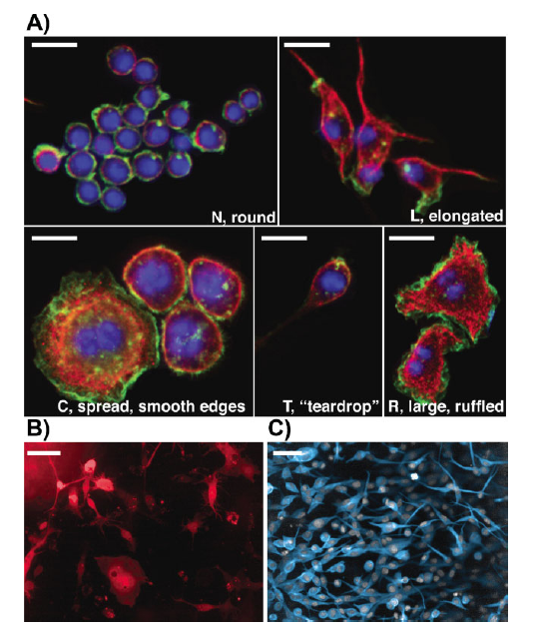
TR&D 3: Topic
Tools for understanding morphological/dynamic information in cells
Today: focus on cell shapes
Yin et al, BioEssays, 2014.
Notes:
Broad topic: understanding morphological information from microscopy images (and movies) of cells. More than an image analysis component, the idea is combine pattern recognition & machine learning, image processing and analysis, optics, fluorescence, knowledge about cells, etc., to derive computational tools in modeling and simulation efforts → aid the process of understanding the cell.
Today our focus will be discussing work we have done on computational methods for understand biological shapes.
Shapes adopted by wild-type Drosophila Kc Heomocytes
Drosophila BG-2 neuronal cells

Slide 4
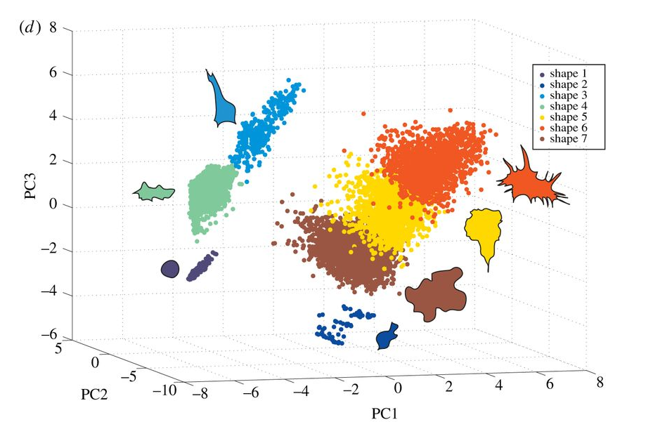
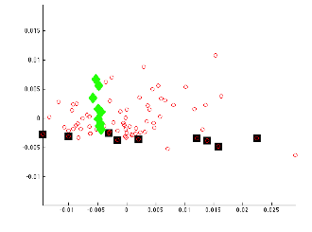
Modeling information in cell images
Method 1: descriptive
Method 2: generative models
Sailem et al, Open Biology, 2014
Rohde et al, Cytometry, 2008
Notes:
Why generative modeling?
Because it allows for modeling and simulation.
Support biochemical reaction modeling.
Enhance physiological understanding capabilities
Framework for integrating models from many experiments
Aid validation for microscopy image algorithms by providing simulation results.

Slide 5

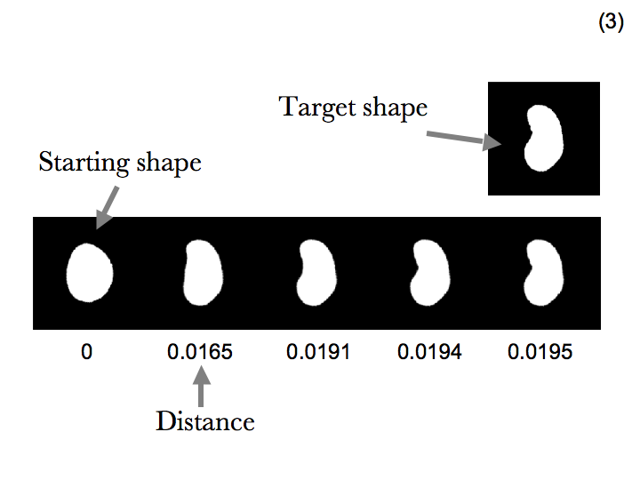
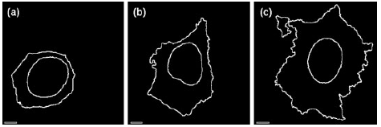
Generative models
Parametric
Non-parametric
nuclear shape
cell shape
shape space
Zhao, Murphy, Cytometry, 2007
Rohde,…, Murphy, Cytometry, 2008
Based on work of Miller et al., Quart. Appl. Math. 1998
Notes:
Why non parametric
Allows for certain flexibilities more easily.
Based on characteristic functions (modeling nested shapes possible)
Maps entire coordinate system as well (understanding spatial correspondences)
Is naturally combined with the notion of a distance (certain physical meaning)
Explicit control points, landmarks, a priori correspondences not needed
“Higher resolution” modeling.

Slide 6
Deformation-based shape distances
Shapes can be deformed onto one another.
Goal: Find the mapping which causes least amount of “bending.”
Quantifying the difference between shapes using these deformations:

Slide 7



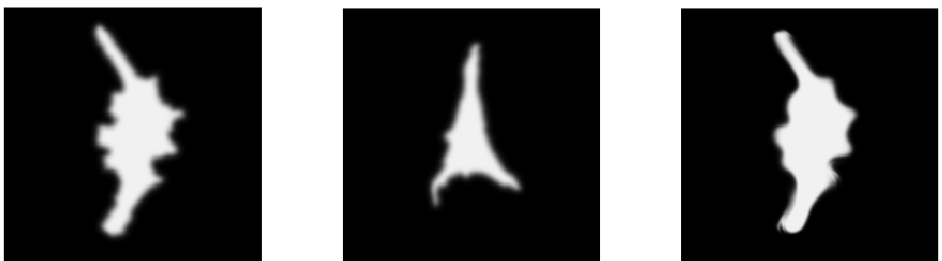
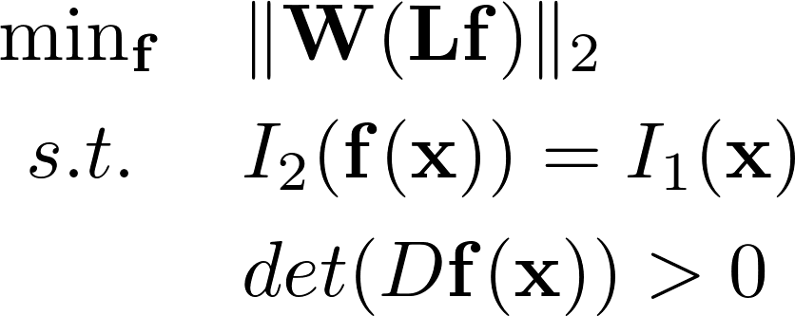
Shape distance definition:
distance
Previous work: based on the “large deformation diffeomorphic metric mapping” (LDDMM) work of Miller et al, JHU.
Improvements described here:
  Robustness, more difficult shapes
  Make the method faster
  Provide options regarding:
    types of differences to measure
    allowing for different regions have different penalties
Notes:
Our hope is that this might have similar effects that our initial idea of using these kinds of non-parametric methods did a few years back.
That is: allow us, collaborators, and other scientists to more easily address a variety of modeling, simulation, analysis problems in cell biology.

Slide 8
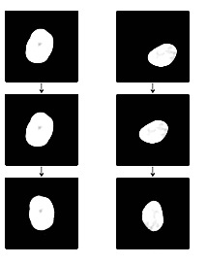
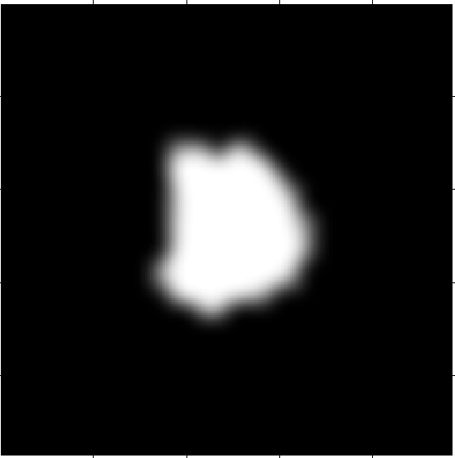
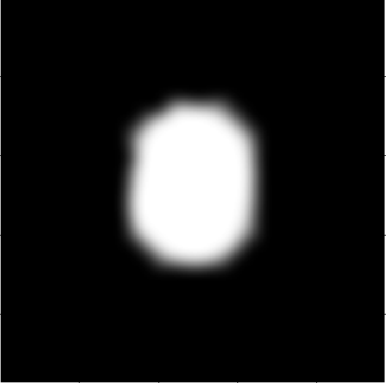
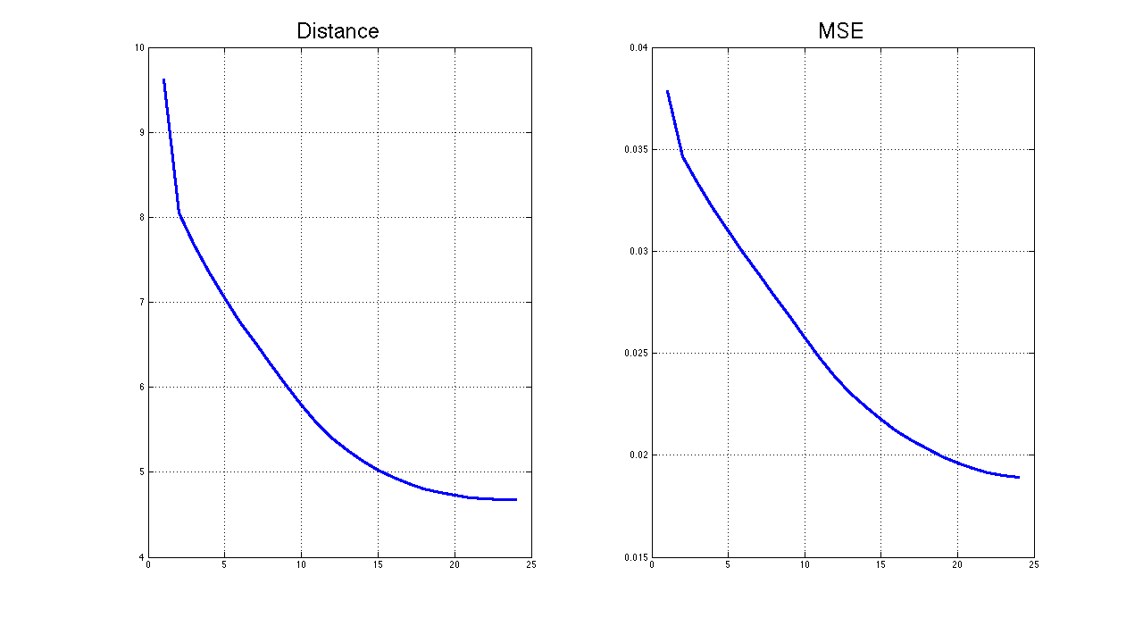

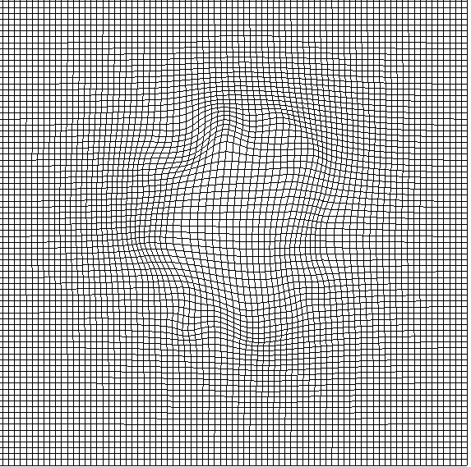
Outline of the method
Preprocessing:
Morphological analysis
Centering
Rotation
Initial mapping:
Multi-resolution MSE based
Smooth diffeomorphic mapping
Energy minimization:
Symmetric energy function
Physically meaningful
Gradient descent
Energy
Gradient descent iteration

Slide 9
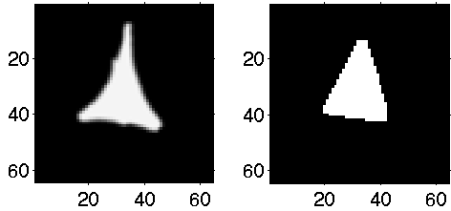

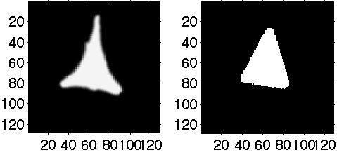
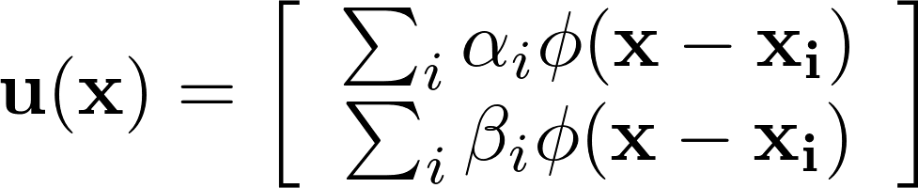
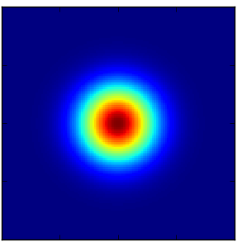

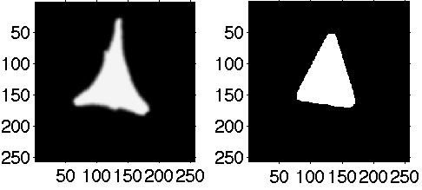
Smooth initial invertible mapping
Robust smooth invertible initial mapping:
  Penalized MSE:
  Solved by a multi-resolution gradient descent approach.
Interpolate &
Multiply by 2

Slide 10
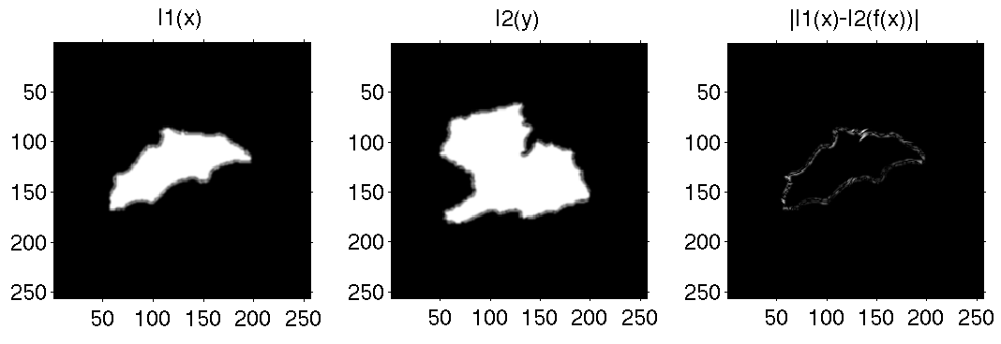
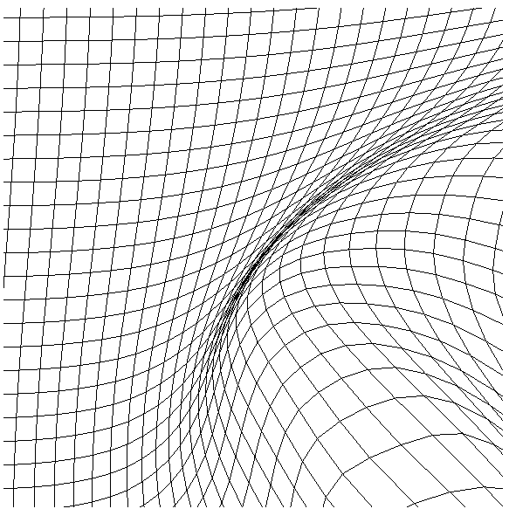
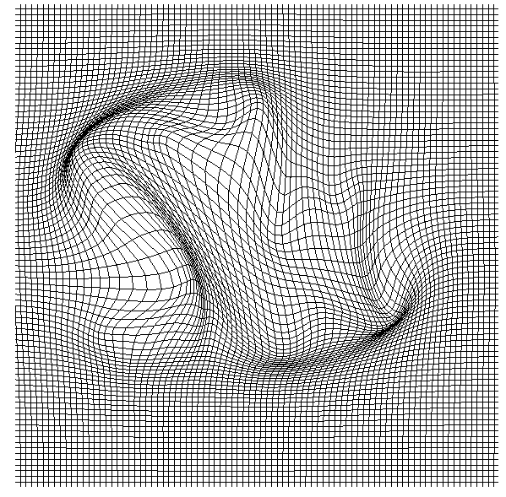
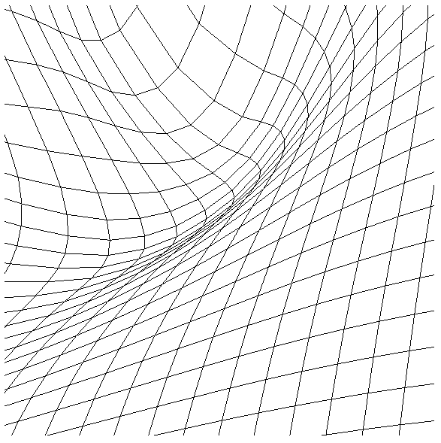
Smooth initial invertible mapping
Elapsed time= 3.96 sec

Slide 11
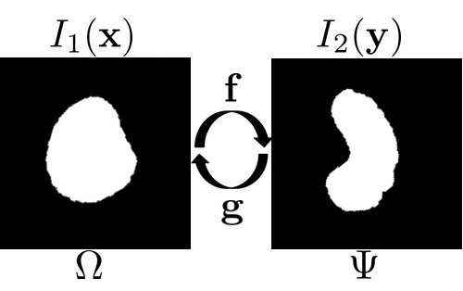
Physically meaningful energy terms
From continuum mechanics, the strain rate tensor, E, is defined as:
Based on f and E, we propose the following energy terms:
Viscous friction:
Volume change:
Total mass transport:
Compression:

Slide 12



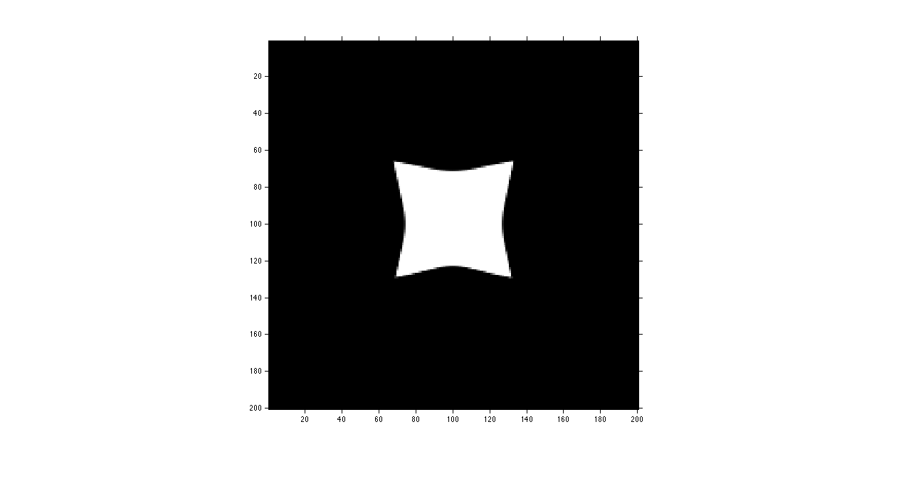


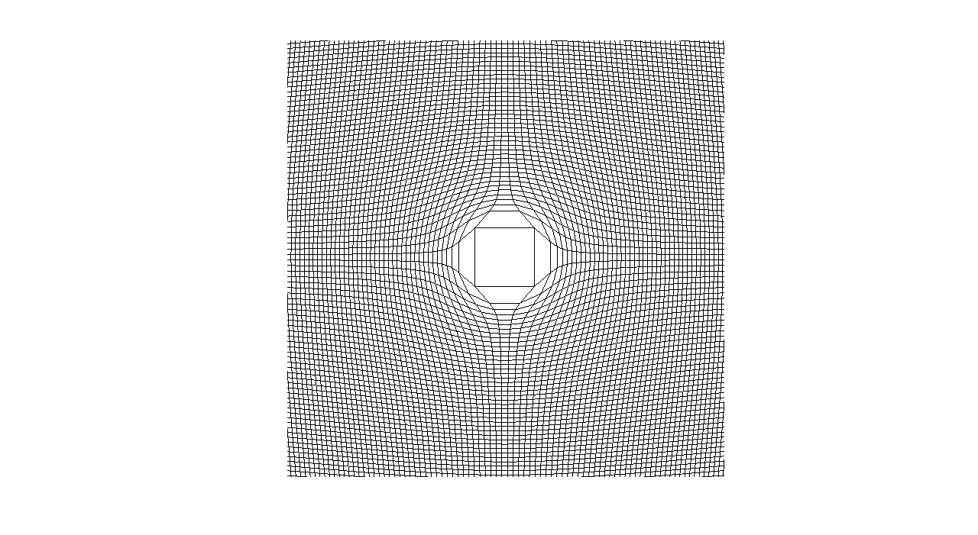
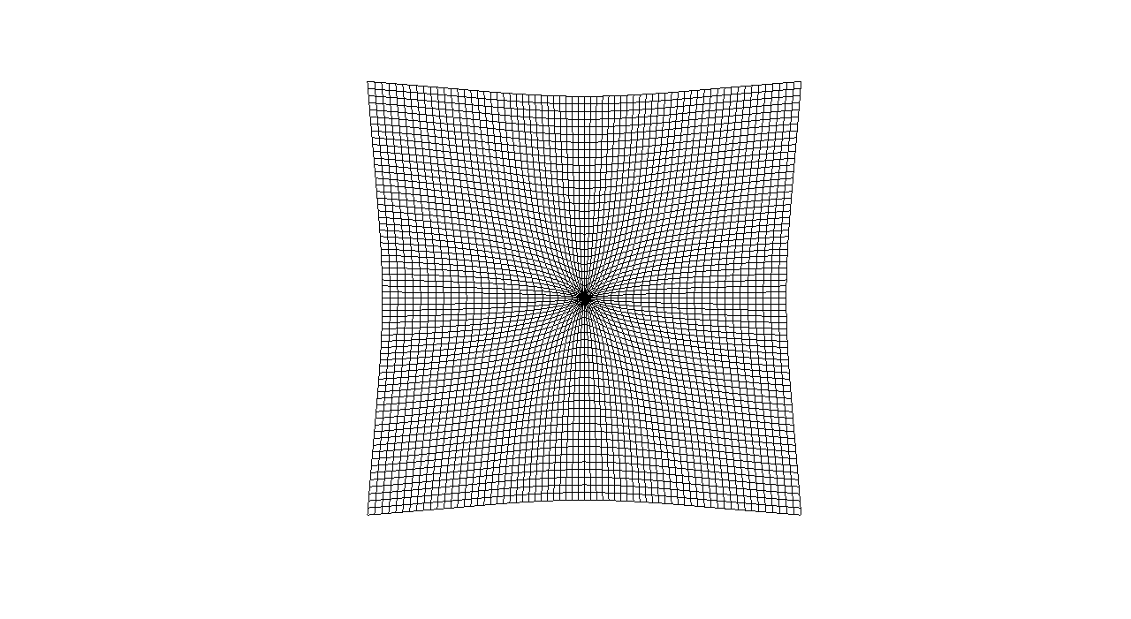

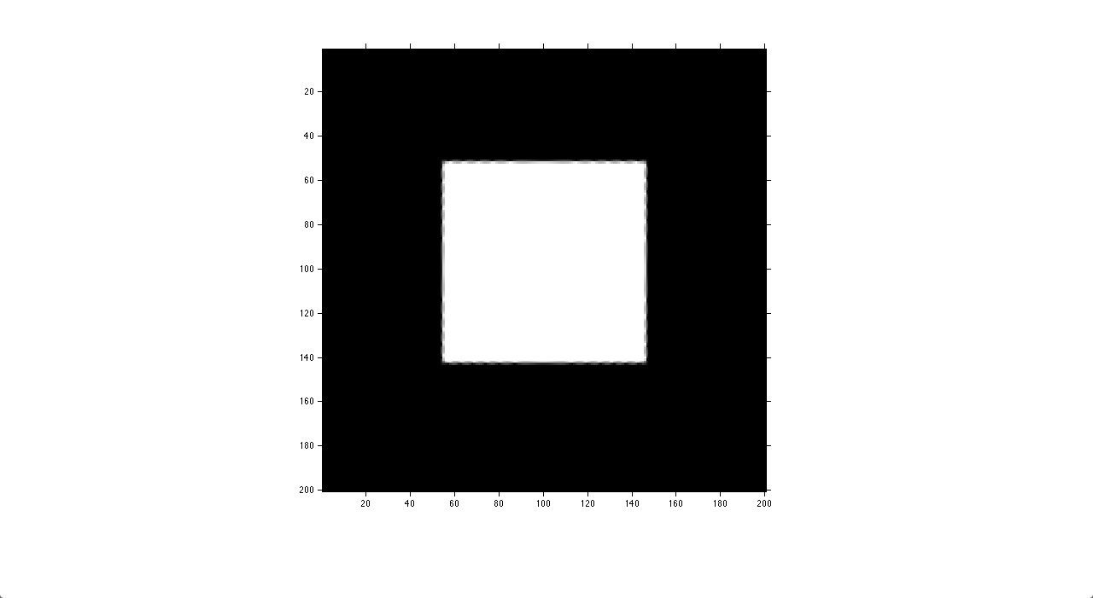

Symmetrizing the energy terms
The symmetric energy terms are defined as,
We avoid the calculation of the inverse map, g, by rewriting the inverse energy terms as a function of the forward mapping. For instance,
where, n=2,3 is the dimension of the problem and is the k’th order symmetric polynomial of the eigenvalues of the Jacobian matrix.

Slide 13
Symmetric energy terms

Slide 14
Symmetrized similarity measure
For two shape images, the symmetrized similarity measure is defined as
Where are the mixing coefficients of energy terms.
Measurement calibration:
The mixing coefficients are tuned to incorporate the relative importance of each term:
  User input
  Normalization with respect to data

Slide 15
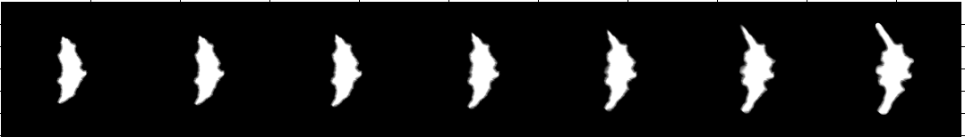
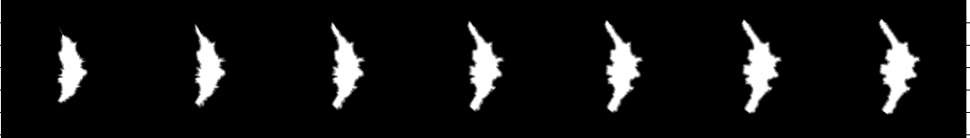
Why symmetry?
With a non symmetric energy, computations are order dependent.
Forward
Backward

Slide 16
Why symmetry?
With a symmetric energy, same answer either way.
Forward
Backward

Slide 17
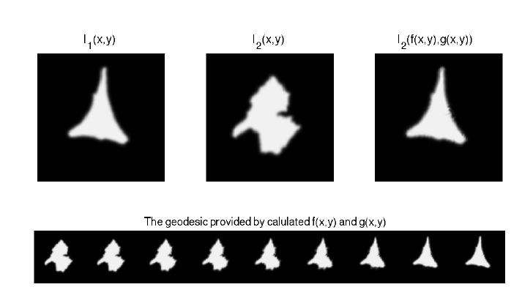
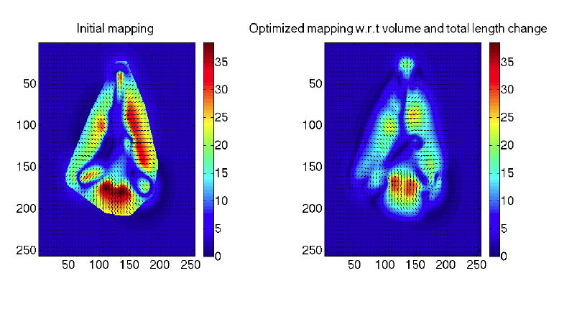
Sample result

Slide 18

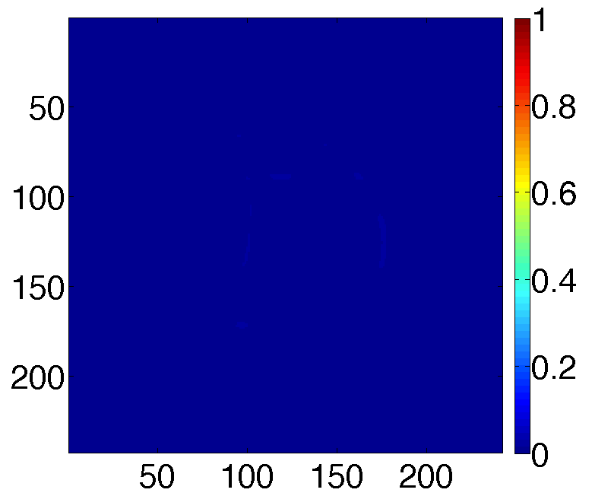


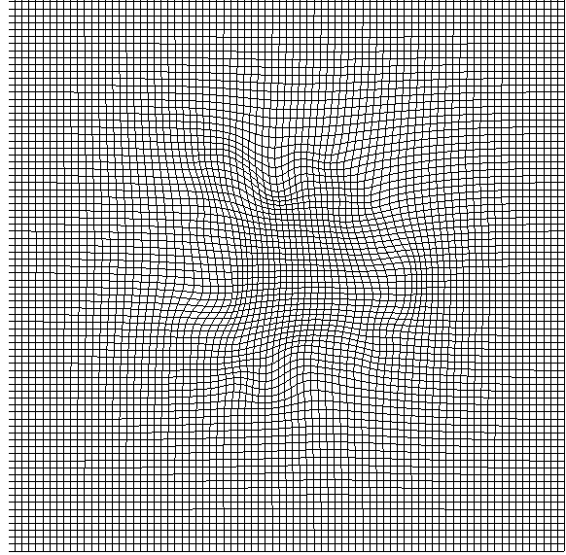
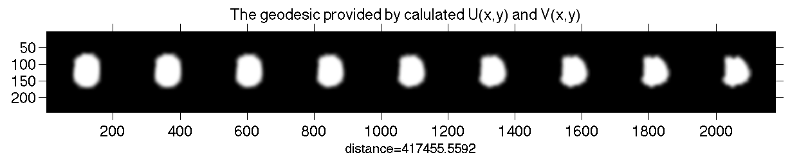
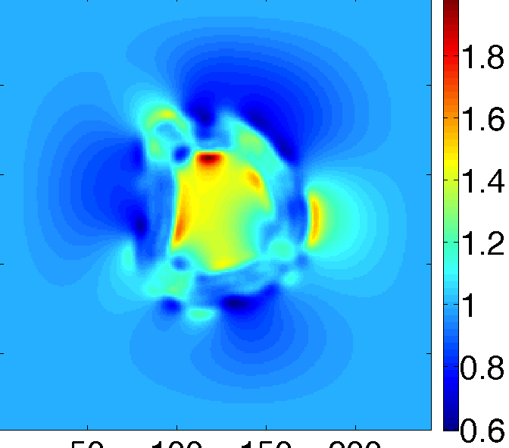
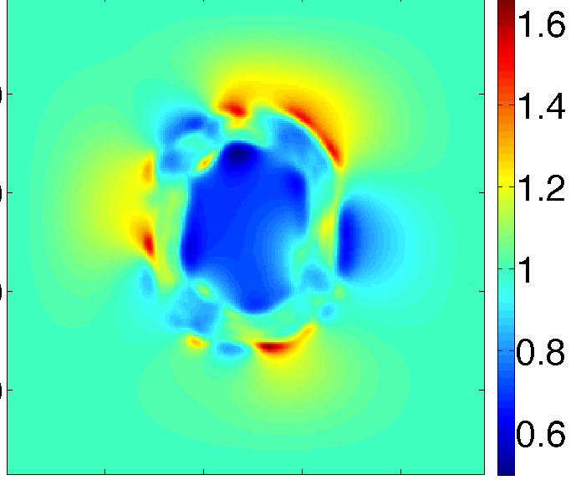
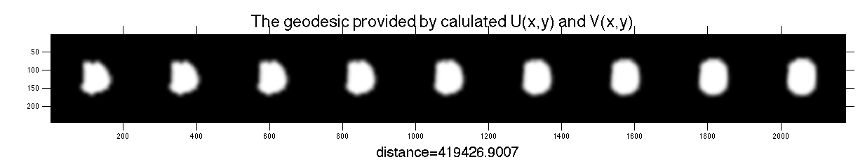
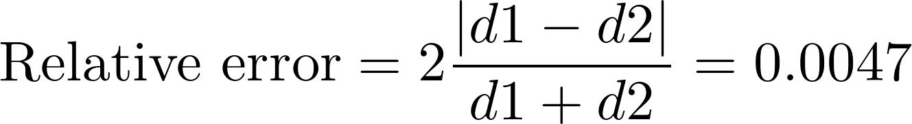
Sample result

Slide 19
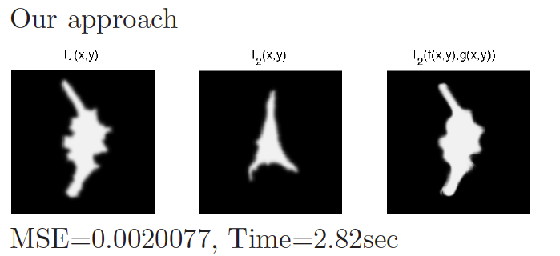
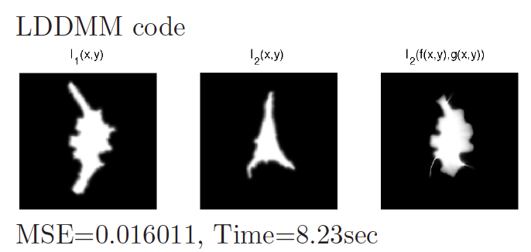
Comparison with LDDMM
Large errors

Slide 20
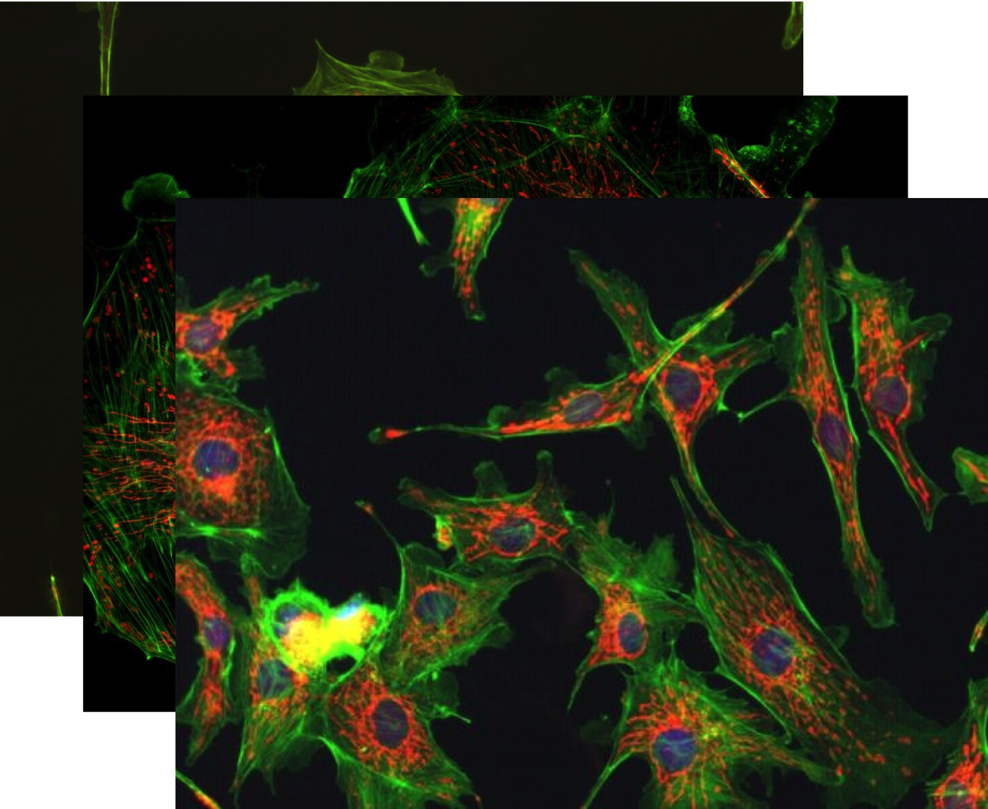
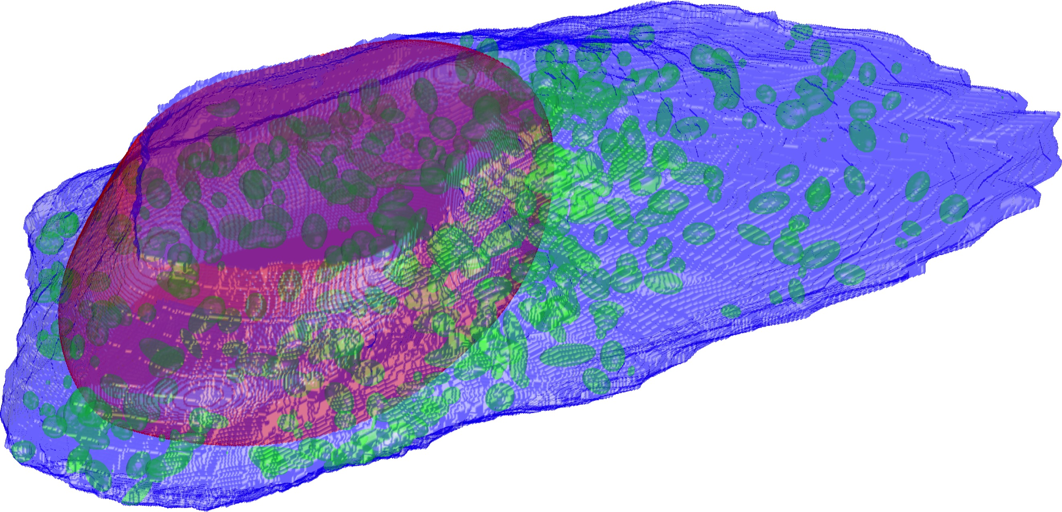
Current & Future work
Finish 3D implementation
Finish testing with sample applications
Integrate into our CellOrganizer
Move on to transport-based distances for densities (e.g. proteins)
CellOrganizer.org
Microscopy images
3D cell model

Slide 21

Thank you

