Slide 1
Extending the Weighted Ensemble methodology to simulations of cell-scale spatially resolved systems
Daniel M. Zuckerman
Department of Computational & Systems Biology
University of Pittsburgh

Slide 2
Long-term challenges for (stochastic) cell-scale simulations
Spatial
Rule-based
Increasing complexity
Cell Model Resolution
Good sampling not possible
Simple nodes
Small network
Organelle/large network
Whole cell
System size

Slide 3
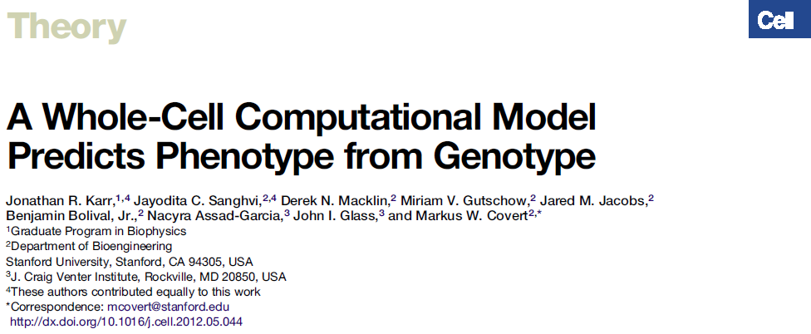
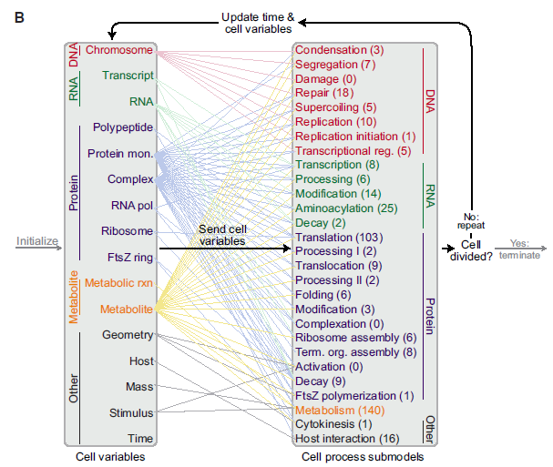
Complexity is here
Organism: human pathogen
Mycoplasma genitalium
[Cell, 2012]

Slide 4
Basic Weighted Ensemble
[Huber & Kim, 1996]
[Donovan, Sedgewick, Faeder, Zuckerman, J. Chem. Phys, 2013]

Slide 5
WE is a “meta method”
No software-specific parallelization required
Scripting-level: Requires only ability to start, stop, and re-start simulations
  Competing methods (e.g., Forward Flux Sampling) require difficult modifications to source code
No biasing of trajectories
  Some competing methods (wSSA) require detailed bias optimization – difficult to scale to complex systems
WESTPA implementation (led by L. Chong, U. Pittsburgh Chemistry)
  Most extensible rare events software
Implemented with
  AMBER, GROMACS, NAMD (molecular simulation)
  BioNetGen, MCell (systems biology/cell scale)

Slide 6
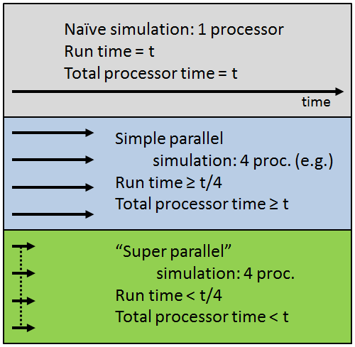
Super-Parallelism
a.k.a. Super-linear scaling
Schematic of time for estimating observables to targeted precision

Slide 7
WE Advances & Limitations
Advances (selected)
  Exactness demonstrated, Markovian/non-Markovian [Zuckerman & co, 2010]
  Extension to steady-states [Zuckerman & co, 2010]
  Extension to non-spatial signaling [Zuckerman, Faeder & co, 2013, TR&D1, 2]
  Simultaneous equil. and non-equil [Zuckerman & co, 2014, TR&D1]
  Extensible WESTPA software [Zuckerman & co, 2015, TR&D1]
  Extension to spatial cell-scale [Zuckerman, Faeder, Murphy & co, under review, TR&D1, 2, 3]
Limitations
  Trajectory correlations (Error analysis must account for it)
  Bins must sub-divide all independent slow coordinates
  Cell-scale systems: More to learn

Slide 8
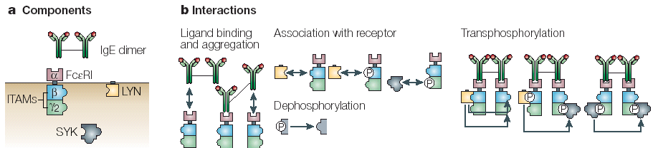
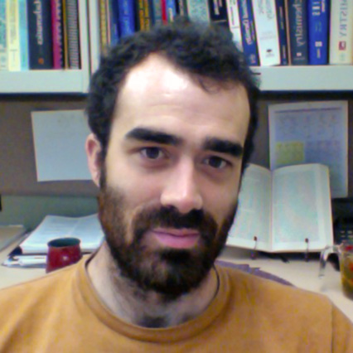
WE applied to non-spatial signaling via the high affinity receptor for IgE (FcεRI) - BioNetGen
354 species, 3680 reactions
[Donovan, Sedgewick, Faeder, Zuckerman, J. Chem. Phys, 2013]
Notes:
Is this useful? Maybe as an opportunity highlight the concision of BNG?

Slide 9
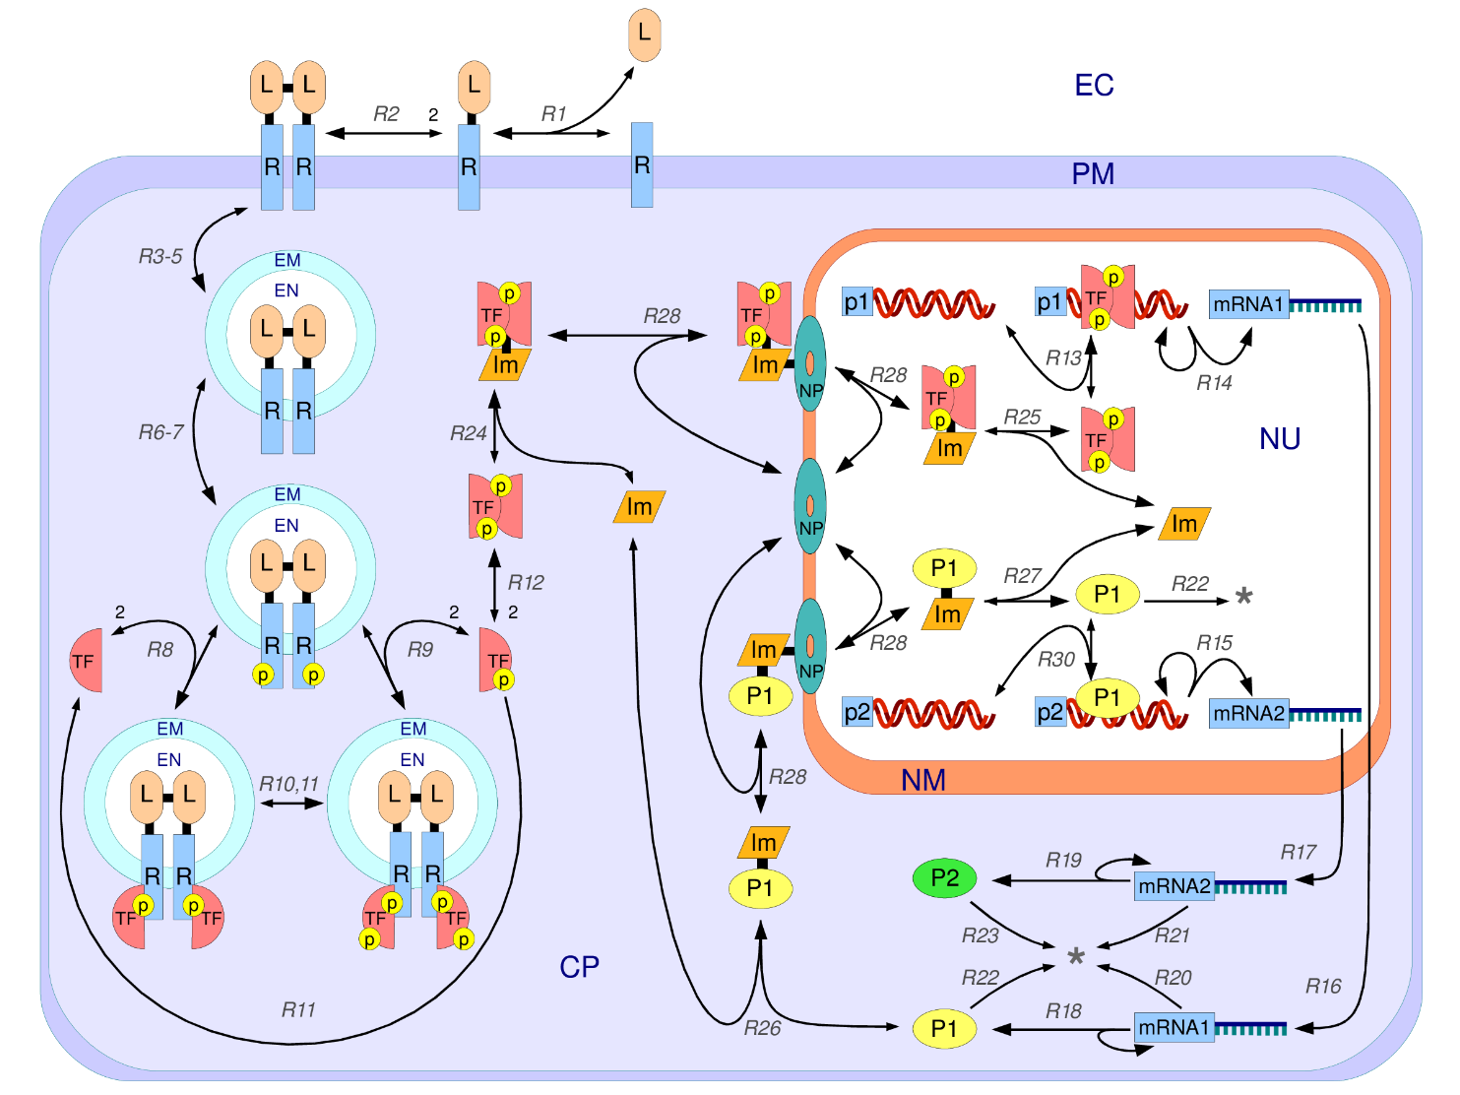
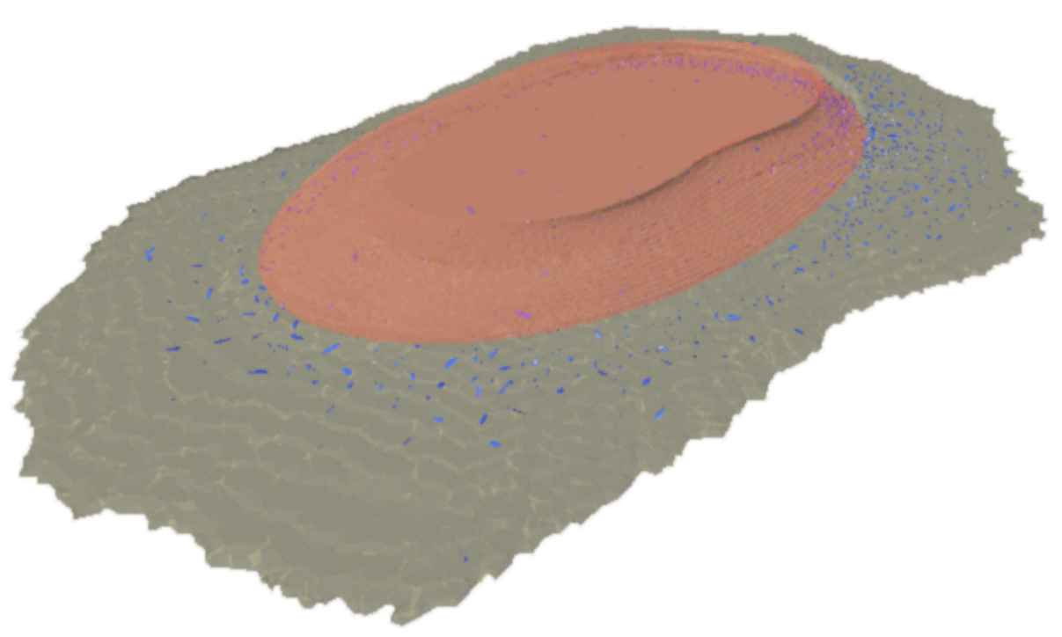
Biochemical reactions embedded in realistic cellular geometry
From
CellOrganizer software [R Murphy]
From
BioNetGen software [J Faeder]
[Donovan, Tapia, Sullivan, Faeder, Murphy, Dittrich, Zuckerman, in revision]

Slide 10
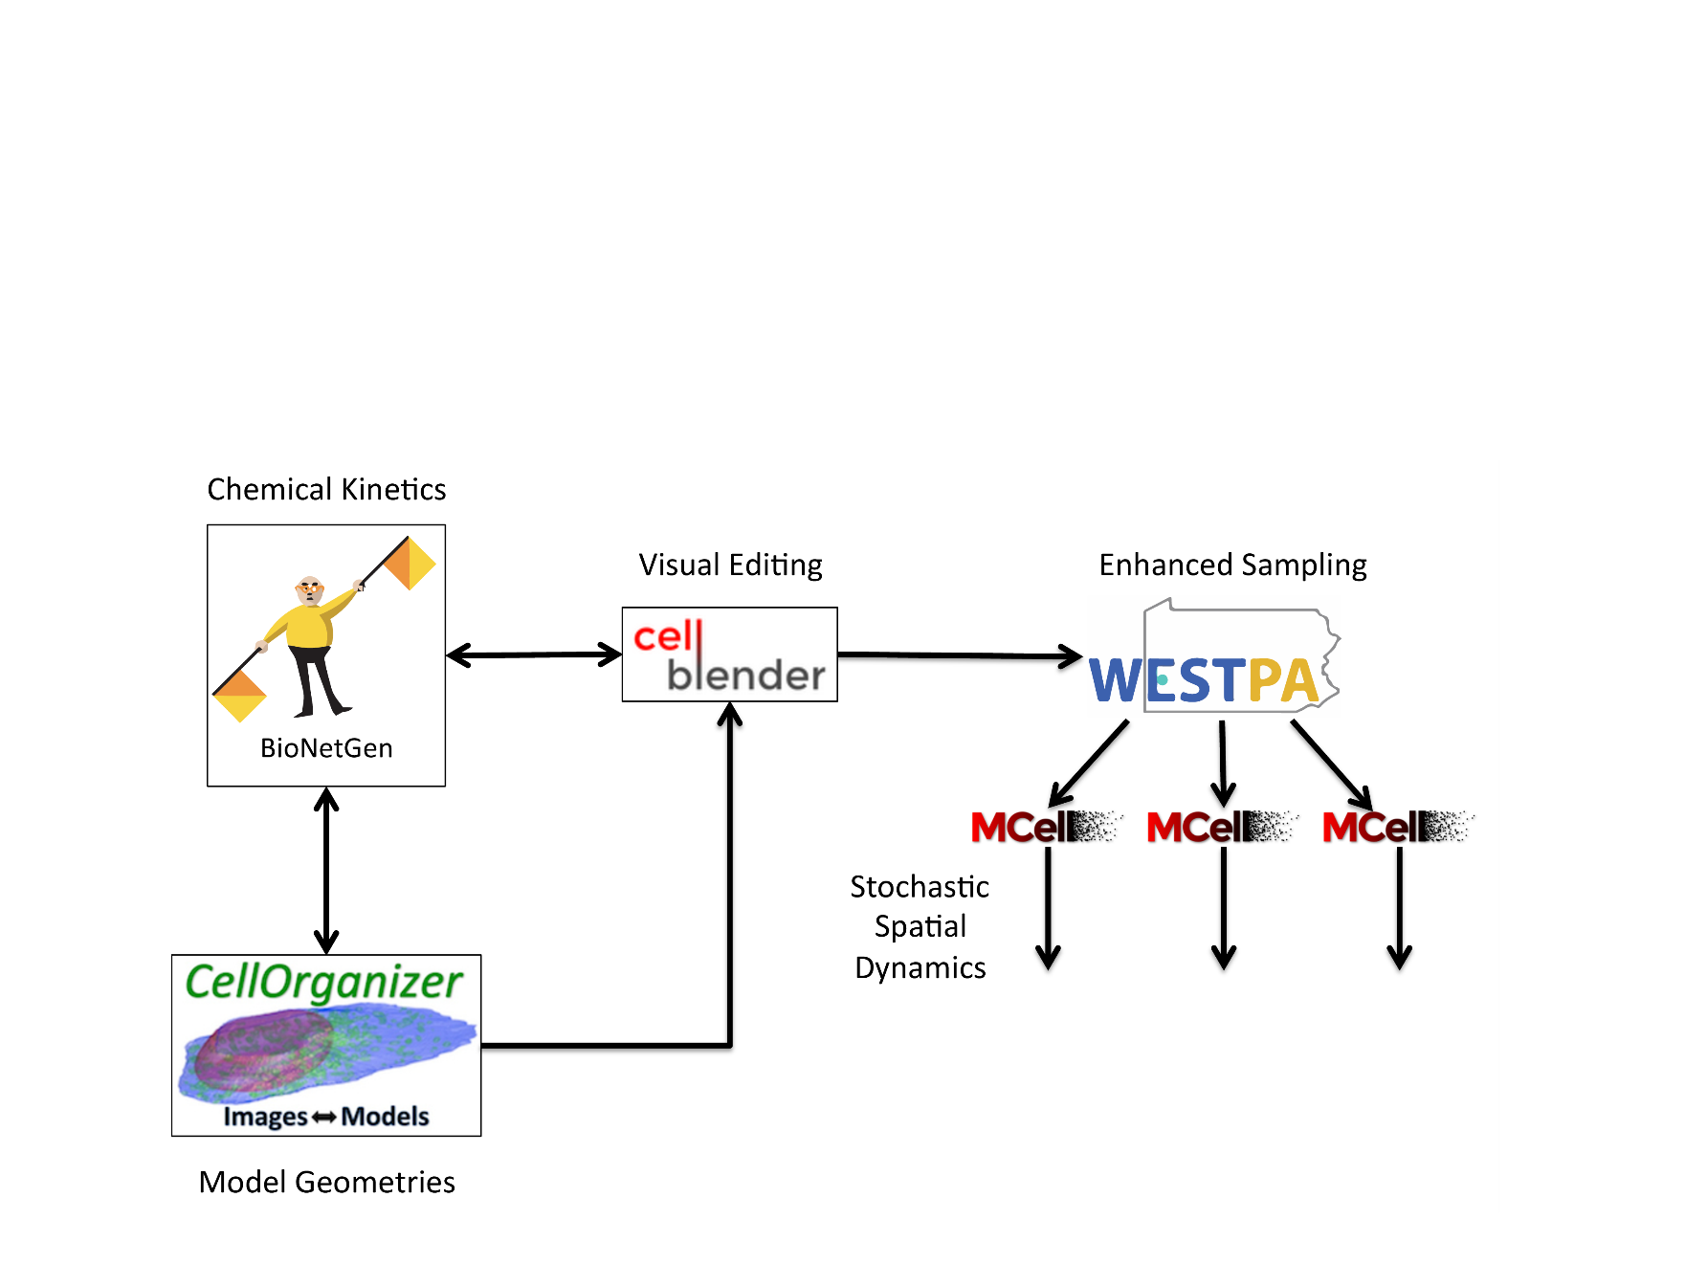

Reaction network & geometry → Mcell, controlled by WESTPA
[Donovan, Tapia, Sullivan, Faeder, Murphy, Dittrich, Zuckerman, in revision]

Slide 11

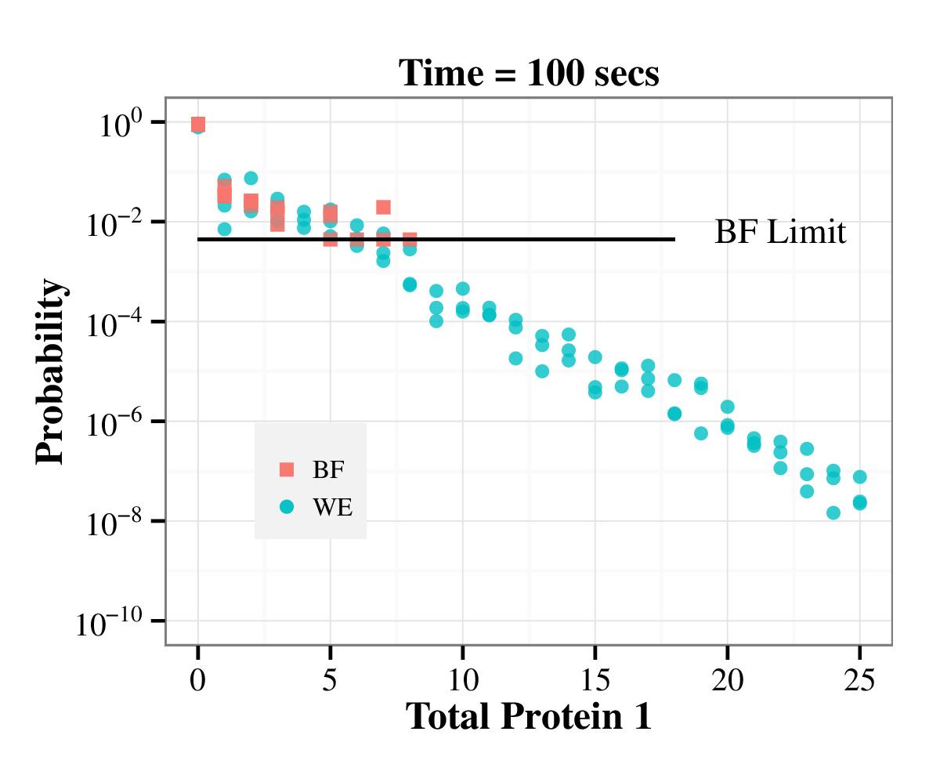
WE allows quantification of rare events
[Donovan, Tapia, Sullivan, Faeder, Murphy, Dittrich, Zuckerman, in revision]

Slide 12
WE “success” depends on observable and setup
[Donovan, Tapia, Sullivan, Faeder, Murphy, Dittrich, Zuckerman, in revision]

Slide 13
Spatial modeling: Frog neuromuscular junction
Implemented in kinetic Monte Carlo package (MCell)
  Kinetically faithful MC based on diffusional paths and reaction rates
Upon activation, mobile calcium ions (yellow) are released from voltage-gated channels (green) that must bind to synapototagmin sites on vesicles (blue).
Vesicle release is triggered by sufficient binding to synapototagmin
[Donovan, Tapia, Sullivan, Faeder, Murphy, Dittrich, Zuckerman, in revision]

Slide 14
NMJ Results
WE resolves rare events at low calcium concentrations
[Donovan, Tapia, Sullivan, Faeder, Murphy, Dittrich, Zuckerman, in revision]

Slide 15
Conclusions
Weighted Ensemble significantly advanced via MMBios
WE facilitated collaborations between all TR&Ds
Application to cell-scale spatially resolved systems
  Promising results with minimal optimization
Parallel and super-parallel performance
Other advances (not discussed)
  Unbiased non-Markovian kinetic analysis
  Improvement of WESTPA software (helped lead to R01)
Significant future work: Optimizing performance, workflows for cell-scale systems
Support from NSF and NIH

