Slide 1
Associations of hDAT with substrate proteins
Mary H. Cheng
Bahar Lab
Feb 26 2015

Slide 2
Associations of hDAT
Oligomerization of hDAT
MD simulations of hDAT dimer in outward-facing and inward-facing states
G-βγ binding to hDAT (Torres lab)
MD simulations of G protein with hDATs
Exploring substrate efflux path
Drug modulation of hDAT (Sorkin lab)
by AMPH cocaine and orphenadrine (joint manuscript with Sorkin lab submitted)
PIP₂ binding sites in hDAT (Sorkin lab)
CamKII binding sites in hDAT
PICK1 binding sites in hDAT
Cholesterol binding sites in hDAT

Slide 3
Background and motivation
Experimental study suggests hDATs may exist as dimers or oligomers.
Oligomerization may be required for proper DAT trafficking to the plasma membrane.
Oligomerization may be important for efficient substrate transport.
hDAT oligomer may provide novel interfacial interactions for substrate protein binding.
Sorkina T., Doolen, Galperin, Zahniser, and Sorkin A., JBC 2003; 278: 28274-28283
Torres G., Carneiro, Seamans, Fiorentini, Sweeney, Yao, and Caron MG, JBC 2003; 278: 2731-2739

Slide 4
Alignment of MD-relaxed OF and IF
TM1a
Dimer RMSD: ~3.5 Å

Slide 5
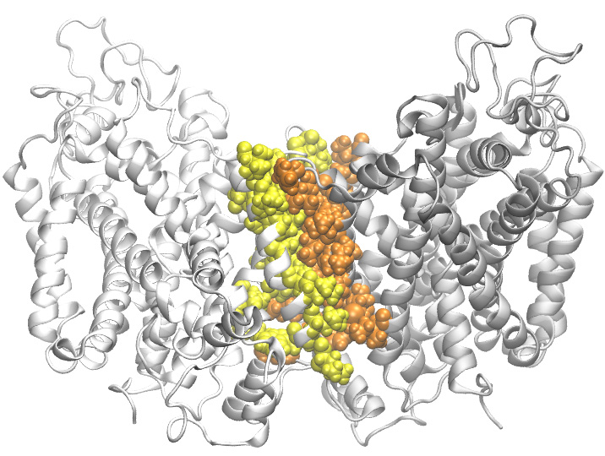
Hydrophobic interface

Slide 6
Investigation of G-protein binding to hDAT
In collaboration with Dr. Torres lab

Slide 7
Background
Gβγ subunits have been reported to directly regulate a diverse array of effector molecules, including ion channels, enzyme and intracellular regulators.
Gβγ-mediated inhibition of voltage-gated calcium channels
A combination of biochemical and functional methods demonstrate that Gβγ subunits regulate DAT activity.
Biochemical experiment shows a direct interaction with DAT and Gβγ subunits.
Activation of Gβγ resulted in inhibition of hDAT function.
Garcia-Olivares, J., Torres-Salazar D., Owens, W, Baust T, Siderovski, Amara SG, Zhu J, Daws
LC, Torres GE, PLOS one 2013;8: e59788

Slide 8
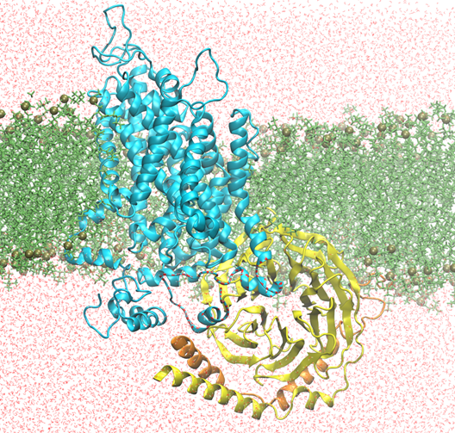
MD simulations of G-protein binding to human dopamine transporter
hDAT
Water
Lipids
G protein β
G protein γ
Notes:
We performed more than 50 ns MD simulations of G-protein binding to hDAT

Slide 9
Interfacial hydrophobic interactions
Orange surf: hydrophobic residues from
hDAT within 3 Å of G protein
Cyan surf: hydrophobic resides from G
protein within 3 Å of hDAT
Notes:
The majority interfacial interactions are hydrophobic interactions

Slide 10
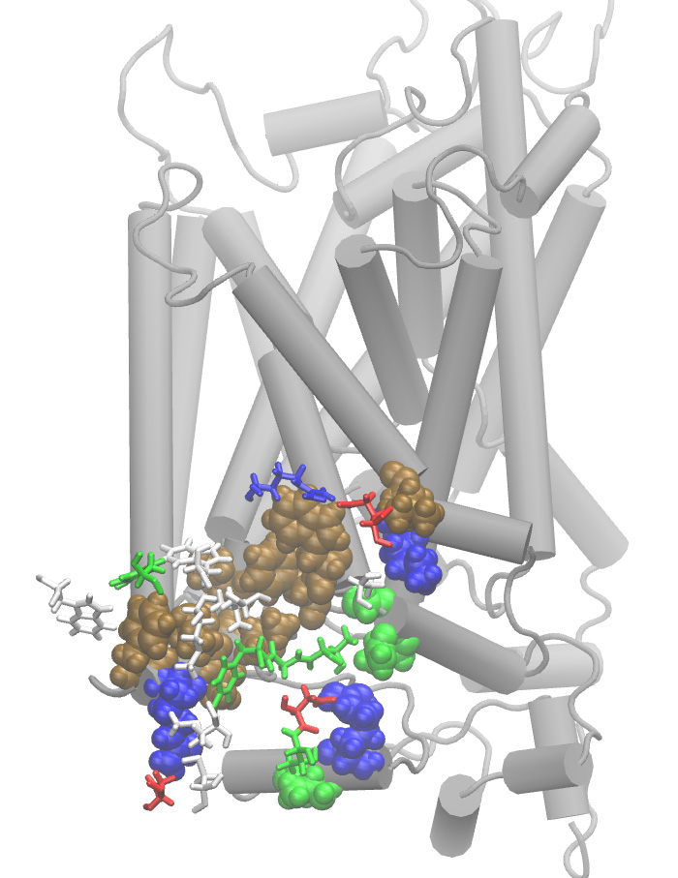
Interfacial salt-bridging
Two interfacial salt bridges:
(1) DAT-R588 and GB-D228
(2) DAT-R610 and GB-D163
DAT-R610
DAT-R588
GB-D163
GB-D228
Notes:
Two salt-bridges may be involved to contribute the interfacial interactions.

Slide 11
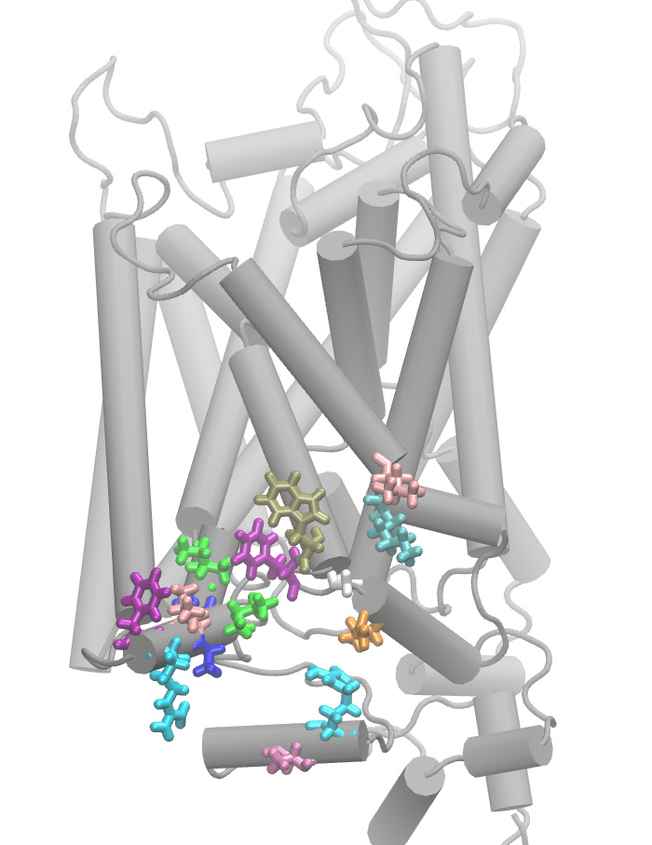
MD suggested mutations
G protein may interact with hDAT monomer
C-terminus including F587 R588 L591 A592 A594 R610
TM10 (W497 F498 G500 Q503), TM11 (L526 K525)
F498
W497
L526
I137
A594
K525
L591
G500
Q503
F587
I595
A592
R610
R588
T613

Slide 12
Conclusions
G-protein is able to bind near the C-terminal of hDAT
The binding of G-protein affects hDAT function not only locally through hydrophobic and/or salt-bridging interactions, but also globally effects the hDAT dynamics.
Particularly, G-protein induces outward expansion of TM11 and TM2, which may result in continuous water channel running from EC to IC.

