Slide 1
Investigation of Spatial Effects on Dopamine Reuptake Mechanism
Cihan Kaya
12/15/2015

Slide 2
Aims
Build and simulate a spatial model of dopaminergic signaling.
Investigate the effects of
  Spatial distribution or surface density fluctuations of dopamine transporters
  Geometry

Slide 3
Difference between dopaminergic and glutamatergic synapses
Property | Dopamine | Glutamate | refs
Transporter localization | DA axons, somata and dendrites | Pre- and postsynaptic, surrounding glia | Nirenberg et al., 1996a Seal and Amara, 1999 Danbolt, 2001
Transporter cycle rate (molecules/s/transporter) | 2–5 | 35 | Wadiche et al., 1995 Povlock and Schenk, 1997 Prasad and Amara, 2001
Intersynaptic distance (forebrain) | 1.2–3.5 μm | 0.5 μm | Doucet et al., 1986 Pickel et al., 1981 Descarries et al., 1996 Cragg and Rice, 2004 Arbuthnott and Wickens, 2007
Receptor localization | extrasynaptic | intra- and extrasynaptic | Sesack et al., 1994 Yung et al., 1995 Hersch et al., 1995 Khan et al., 1998 Ottersen and Landsend, 1997 Galvan et al., 2006
Receptor sensitivity | nM-μM | μM-mM | Richfield et al., 1989 Neve and Neve, 1997
Receptor response time | 1–5 ms | 50 ms - >1 s | Rusakov and Kullman, 1998 Barbour, 2001

Slide 4
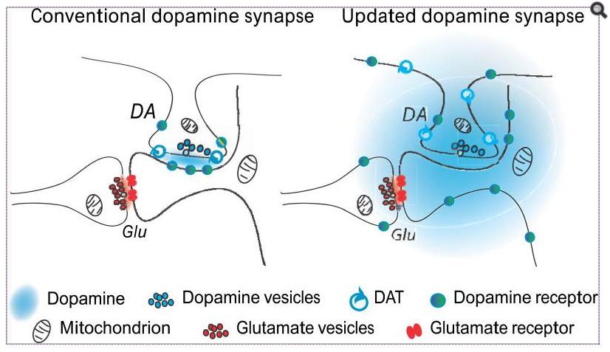
Model
Rice et. al., 2008.

Slide 5
Dopamine reuptake mechanism
Dopamine clearance mediated with two mechanisms:
  Release: Content of a vesicle released instantly with a frequency.
  Uptake: Transporters will clear the EC DA.
Membrane
a

Slide 6
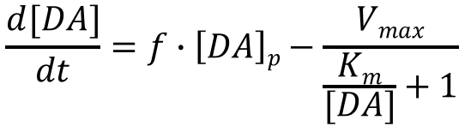
Oldest Model for DA transmission
$$\frac{d[DA]}{dt}=f∙\left[DA\right]p−\frac{Vmax}{\frac{Km}{[DA]}+1}$$
[DA] : extracellular DA concentration
[DA]_{p} : DA concentration of a vesicle
f : frequency of vesicular release
V_{max} : Michelis-Menten max rate,
function of DAT concentration
Uptake term
Issues with uptake term
  Constant V_{max} , should be function of [DAT]
Release term
Issues with release term
  Constant increase in DA concentration
  Release frequency is constant
a
General Concerns
Well-mixed assumption
No spatial information
Garris et. al., 1994.

Slide 7
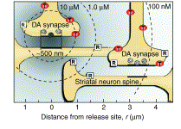

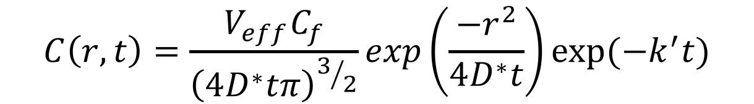

Volume Transmission Model
First order decay
$$C\left(r,t\right)=\frac{V_{eff}C_{f}}{{\left(4D^{∗}tπ\right)}^{3/2}}exp\left(\frac{−r^{2}}{4D^{∗}t}\right)exp⁡(−k^{′}t)$$
Gaussian diffusion
$$V_{eff}=\frac{U}{α}$$
$$D^{∗}=\frac{D}{λ^{2}}$$
Two parameter for spatial variables
Single synapse model with single release
⍺: void fraction
λ: tortuosity
U: total volume
C_{f}: # of DA in vesicles
k’: DA uptake rate
General Concerns
Oversimplification of space and heterogeneity
First order reaction mechanism for transporters
Rice et. al., 2004.

Slide 8
Simple Spatial Model
Parameter | Value
Number of dopamine molecules per vesicle | 1900
Extracellular volume associated with a release site (dorsal striatum) | 2 × 10⁻¹⁵ l
Number of DAT associated with a release site | 2800
DAT catalytic rate | 9 s⁻¹
DAT-DA binding on rate (transfected cells) | 5× 10⁺⁶ M⁻¹ s⁻¹
DAT-DA binding on rate (tissue prep) | 1.3× 10⁺⁸ M⁻¹ s⁻¹
DAT-DA binding off rate | 0.5 s⁻¹
Dopamine diffusion rate | 4 × 10⁻⁶ cm⁻² s⁻¹
DA (extracellular)
DAT-DA
DAT
DA (intracellular)
No reference and no justification
Rest of the parameters are from Michaelis-Menten kinetics.
General Concerns
Introduction of microscopic diffusion with very simple geometry.
Uncertainties and lack of validation of parameters
Rooney et. al., 2015.

Slide 9
New Model
No well-mixed assumption
Microscopic diffusion in the form of Monte Carlo diffusion of DA molecules is implemented.
Image data is utilized to build geometry and place molecules.

Slide 10
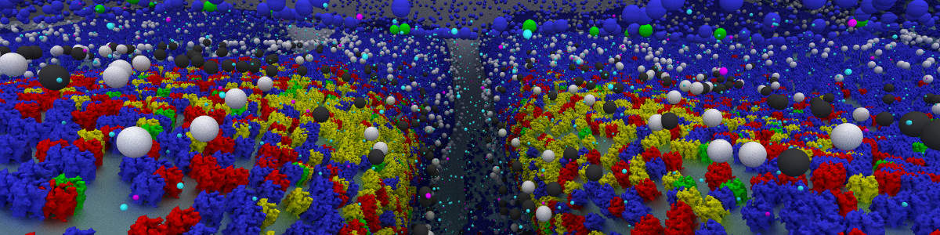
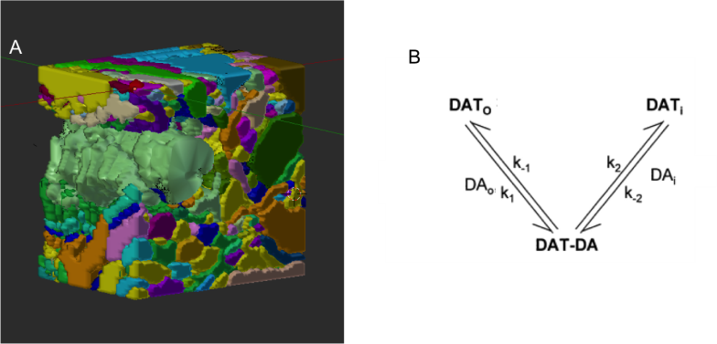
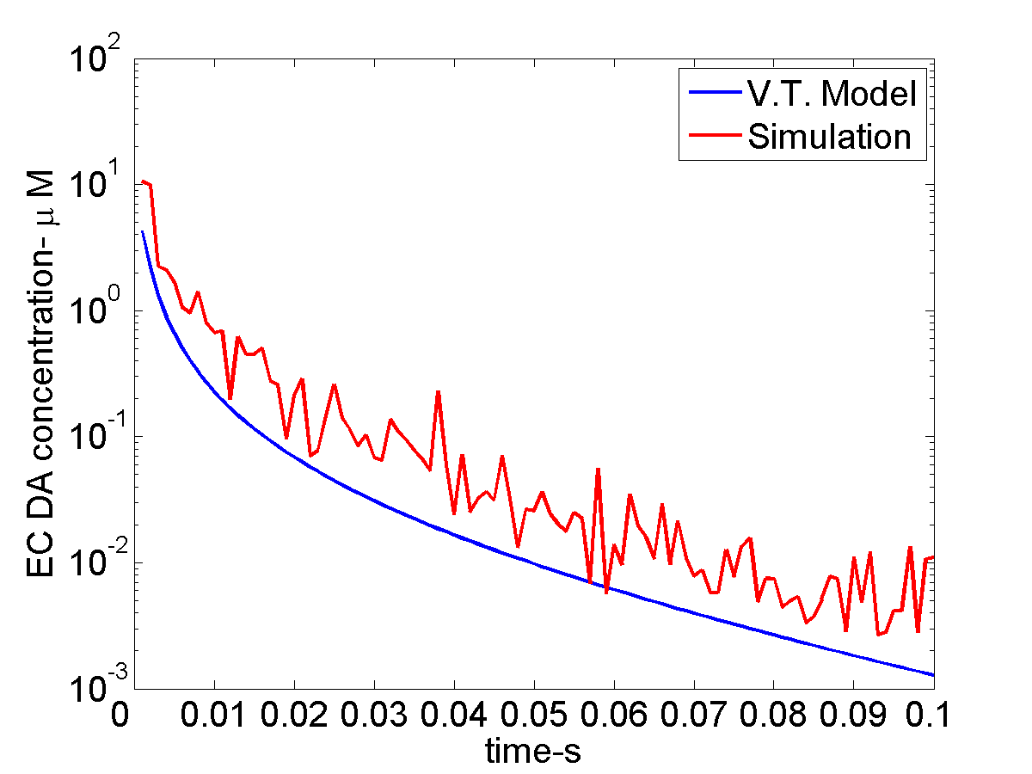
Protocol
Reaction Network
MCell
Garris et. al., 1994
Output Trajectories
3D Geometry
Cardona et. al., 2012

Slide 11
Image Data
10x10 μm stacks with 0.4 μm separation. (18 images)
Mouse striatum (HA-DAT strain) slices
Stained with anti-HA antibodies and Cy3 anti-mouse antibodies.
Red colors are dopamine transporters.
5 μ
Projection (Superposition) of all slices
Block et. al., 2015

Slide 12
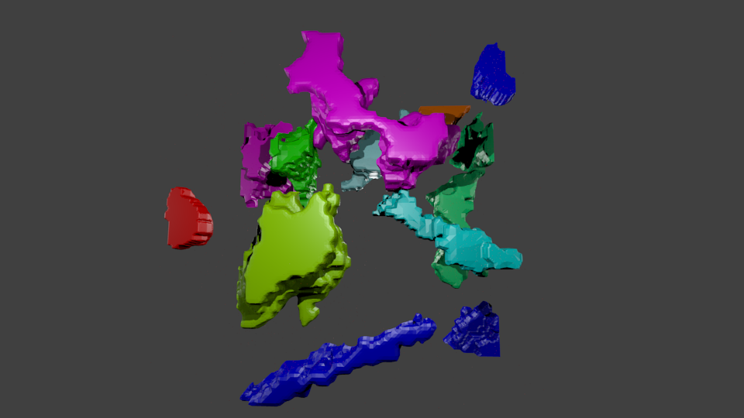
Manual 3D reconstruction
Dopamine transporters are highly expressed on membrane.
Red color is used as membrane stain.
Image reconstructed in ImageJ.
Visualized in Blender.
First Slice
Top view

Slide 13
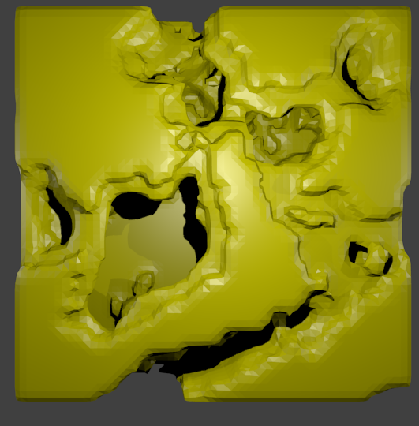
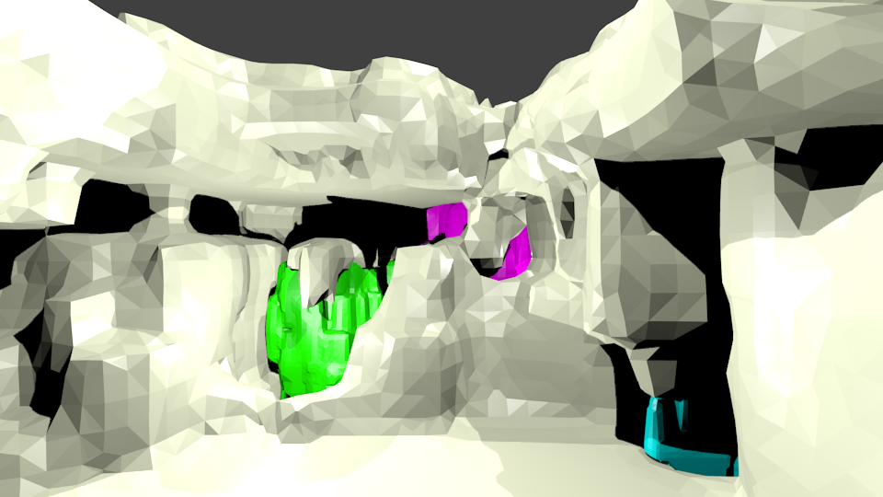
Environment
Remaining portion of the space is filled with other cells which do not have dopamine transporters.
The gap between the DAT containing axons and environment is around 20 nm thick. (Block et. al, 2015)

Slide 14
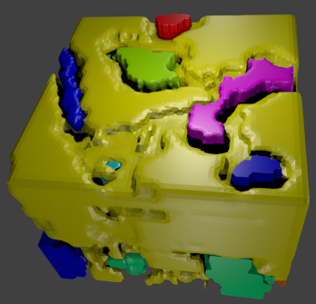
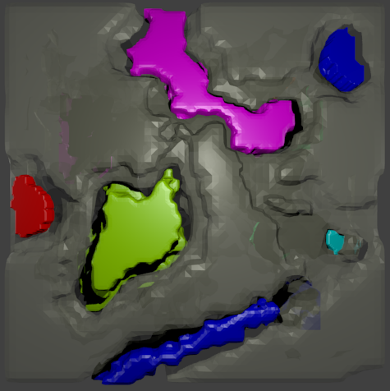
Full reconstructed image
ISOMETRIC VIEW
TOP VIEW

Slide 15
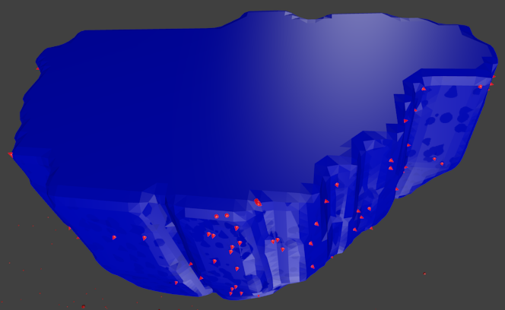
DAT placement according to images
1
3
Large intensity regions have larger DAT density and rest of the axons have a lower density.
Density numbers are used from Block et. al., 2015.

Slide 16
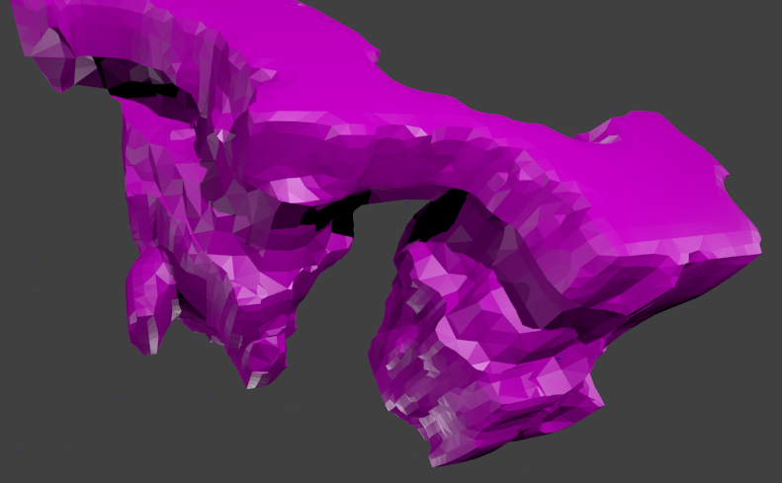
Active zone placement
3
4
Varicosities are determined from images.
The region with low DAT intensity on the varicosity is selected as active zone.
5
6

Slide 17
Kinetics and Simulation Setup
Parameter | Value
Number of dopamine molecules per vesicle | 650
DAT surface density | 55 / μ² and 115 / μ²
DAT catalytic rate | 9 s⁻¹
DAT-DA binding onrate (transfected cells) | 5× 10⁺⁶ M⁻¹ s⁻¹
DAT-DA binding offrate | 0.5 s⁻¹
Dopamine diffusion rate | 4 × 10⁻⁶ cm⁻² s⁻¹
DAT_{i}-DAT_{o} transfer rate | 20 s⁻¹
DA firing rate | 1 Hz
Time step | 1 μ
DA (extracellular)
DAT_{OUT}
DAT_{OUT}-DA
DAT_{IN}
DA (intracellular)
Initially, all DAT are in outward facing state and simulation started with first firing of DA.

Slide 18
Results

Slide 19
Results

Slide 20
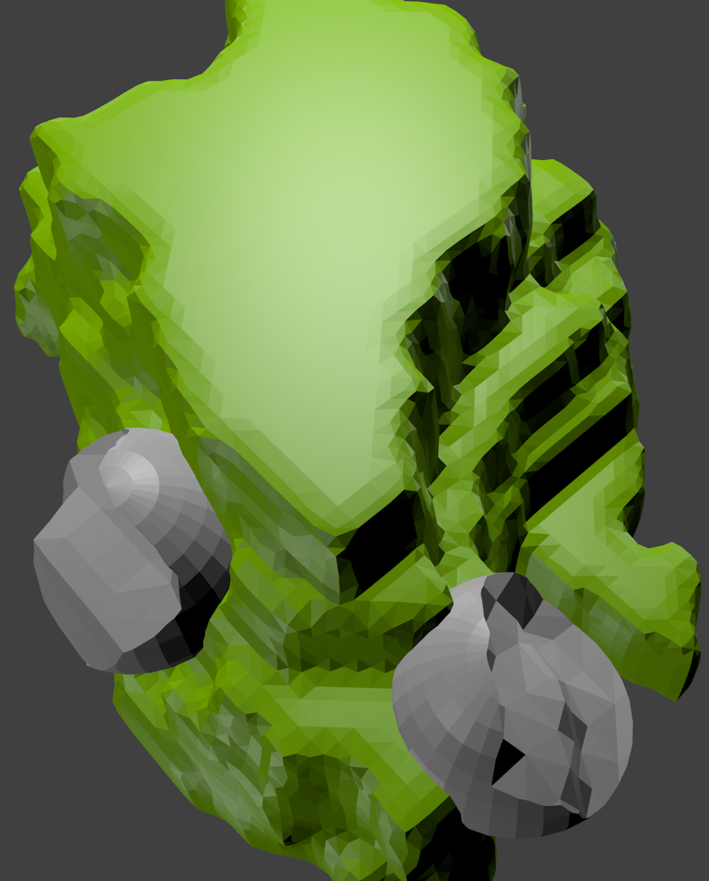
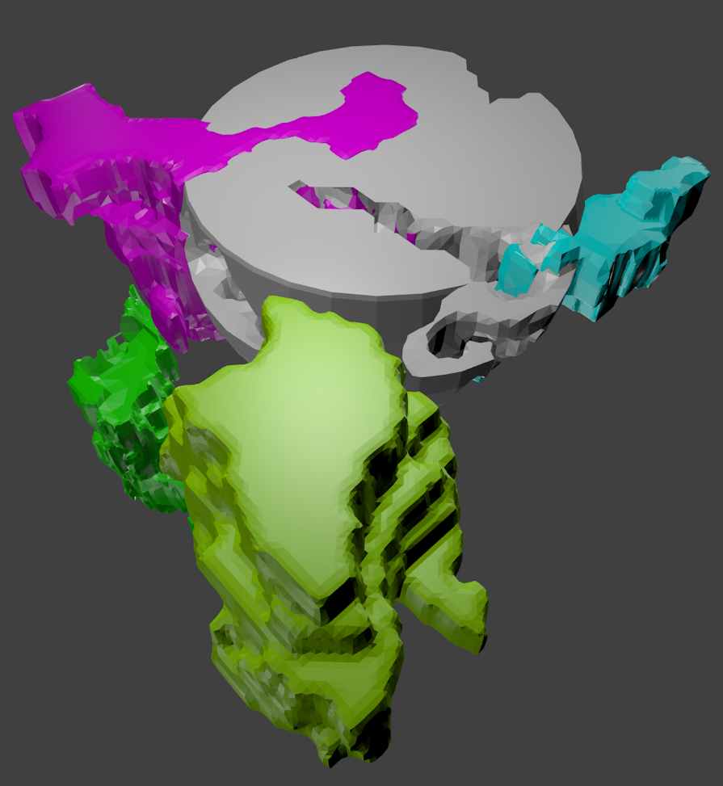
Outputs and analyses
 | Volume (fL) |  | Volume(fL)
Site 1 – 1 μ | 0.196 | Site 2 – 1 μ | 0.187
Site 1 – 2 μ | 1.610 | Site 2 – 2 μ | 1.190
Site 1 – 5 μ | 20.459 | Site 2 – 5 μ | 22.790
Site 1 – 10 μ | 83.881 | Site 2 – 10 μ | 91.600

Slide 21
Sample Results
Due to oversimplification of geometry in volume transmission model, concentration of DA is smaller.
To reach the concentration depicted from volume transmission model, there should be half DA molecules inside volume.

Slide 22
Conclusion
The spatial complexity has a significant effect on DAergic signaling.
Image data is utilized to investigate spatiotemporal dynamics of DAergic signaling.
Previous imaging efforts to investigate DAT transport is useful for predicting EC DA dynamics.

Slide 23
Future work
The model will be simulated with high resolution images (EM).
The correlation between the distribution of DA and DAT is investigated.
Alternative kinetics such as blocking of DAT transport will be investigated.

