Slide 1
Tools for automatically combining biochemical and cell organization models
Devin Sullivan

Slide 2
Motivation
Fluorescence microscopy provides a tool for understanding the impact of spatial organization on the biochemistry of cells.
Simulating biochemical systems within these geometries can improve our understanding of these systems.
Current methods of obtaining such geometries from images is not sufficient for accurately capturing the variability among cells

Slide 3
Benefits of generative models
Represents organelle localization, size and shape more accurately than segmentation
Provides a continuous space for synthesizing and subsequently analyzing changes in cell geometries

Slide 4
Object overlap avoidance
Idealized vesicular organelles should not overlap
By adjusting the core and render sizes we can select how much overlap is appropriate
Core
Core
Rendered
Rendered

Slide 5
Diffeomorphic model learning: Non-rigid image registration
Starting shape
Target shape
1. Rohde G. K., Wang W., Peng T., and Murphy R.F. (2008).

Slide 6
Diffeomorphic model learning: Non-rigid image registration
Starting shape
Target shape
0
0.0165
0.0191
0.0194
0.0195
Distance
1. Rohde G. K., Wang W., Peng T., and Murphy R.F. (2008).

Slide 7
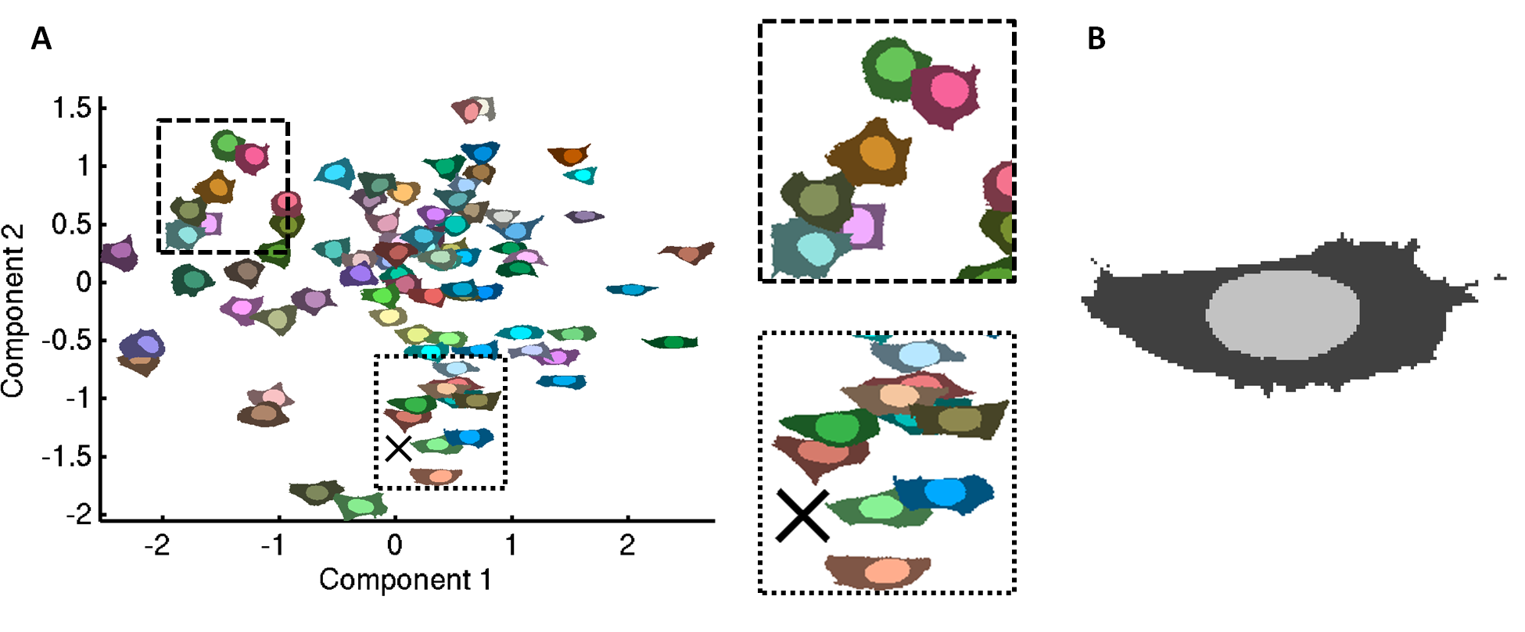
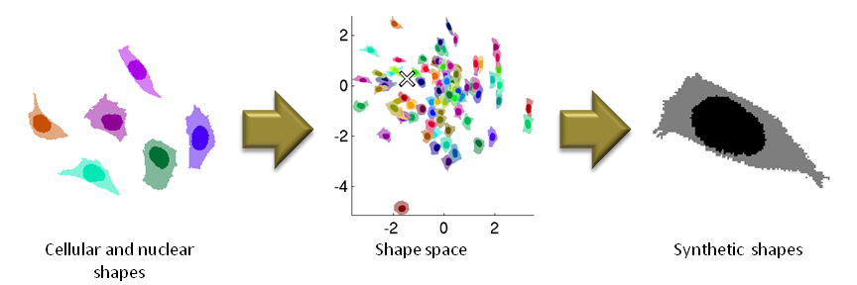
Generating synthetic cells
Use multi-dimensional scaling to create “shape space”
Sample a point in this shape space
Generate synthetic cell by deforming nearby cells
Starting cell
Notes:
LDDMM = non-rigid image registration

Slide 8
Cell shape dynamics
How a cell might change over time
Increasing DNA intensity
time
Cell Shape

Slide 9
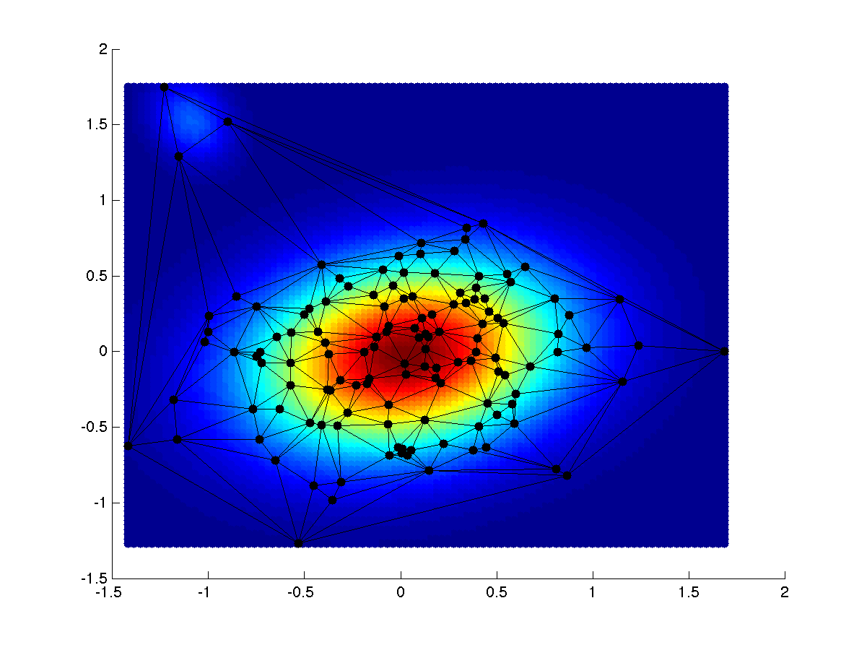
Exploring cellular parameter space
Sample modal instances
Sample outlier instances
Sample a sequence of instances
GMM of 3D HeLa shape space used for intelligent sampling

Slide 10
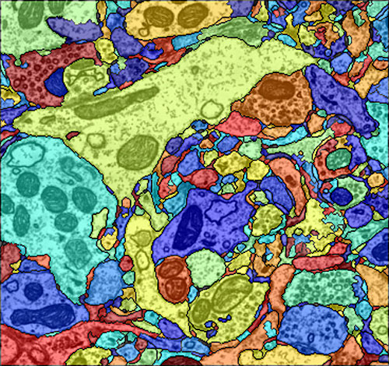
Cellular Systems Modeling: Previous approaches
Vastly simplified geometries
Manual segmentation
Neuronal EM¹
1. Vazquez-Reina, A., Gelbart, M., Huang, D., Lichtman, J., Miller, E., & Pfister, H. 2011

Slide 11
High-throughput spatially realistic simulations
Study the effects of spatial variance caused by
Cell cycle
Diseases
Drugs
Inherent cell variance
Model large systems with high spatial realism
Validate generative model accuracies

Slide 12
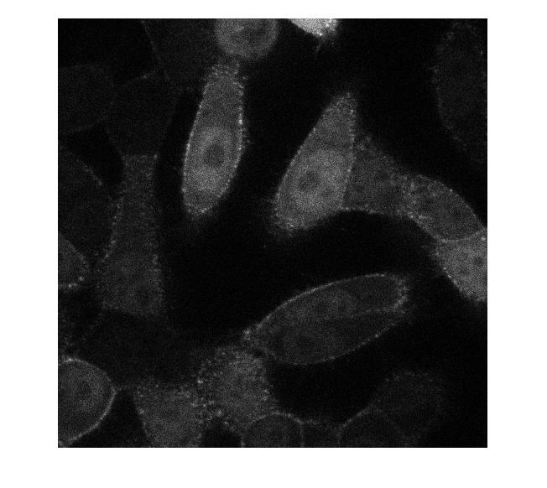
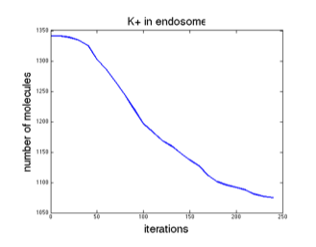
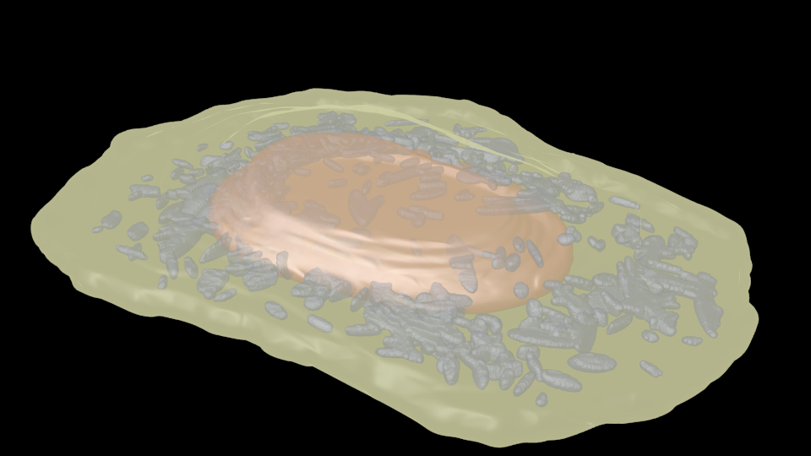
Automation of spatial modeling
BioNetGen
SBML
model
Experiments
&
Literature
Geometric
model
CellOrganizer
Mcell/VCell
SBML-spatial

Slide 13
Automation of spatial modeling
Step 1: Biochemical systems modeling
BioNetGen
SBML
model
Experiments
&
Literature
Geometric
model
CellOrganizer
Mcell/VCell
SBML-spatial+SBML

Slide 14
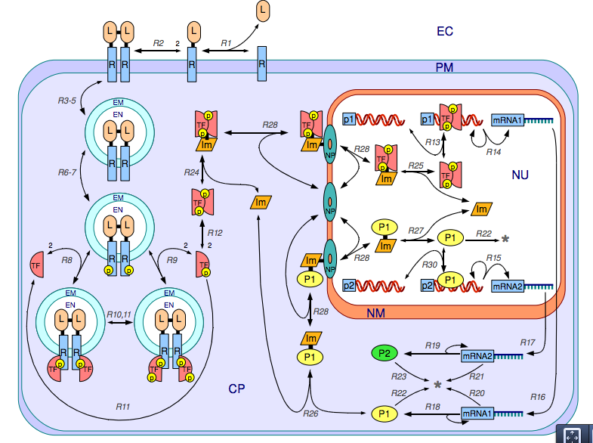
Example system
354 reactions
78 species
7 “compartments”

Slide 15
Example system
354 reactions
78 species
7 “compartments”
Analyze the expression leve of P2

Slide 16
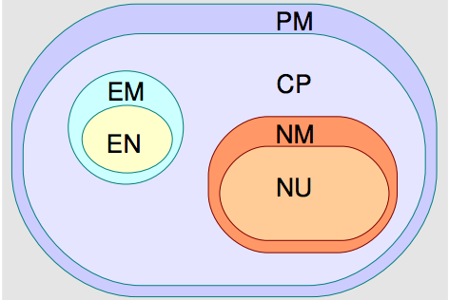
Why rule-based models
Traditional Modeling
354 reactions
78 species
Rule-Based Modeling
30 rules
10 molecule types

Slide 17
ODE modeling
Obtain a general idea of system behavior
Check simulation to confirm “reasonable” parameters/behaviors

Slide 18
Automation of spatial modeling
Step 1: Biochemical systems modeling
BioNetGen
SBML
model
Experiments
&
Literature
Step 2: Creating realistic spatial geometries
Geometric
model
CellOrganizer
Mcell/VCell
SBML-spatial+SBML

Slide 19
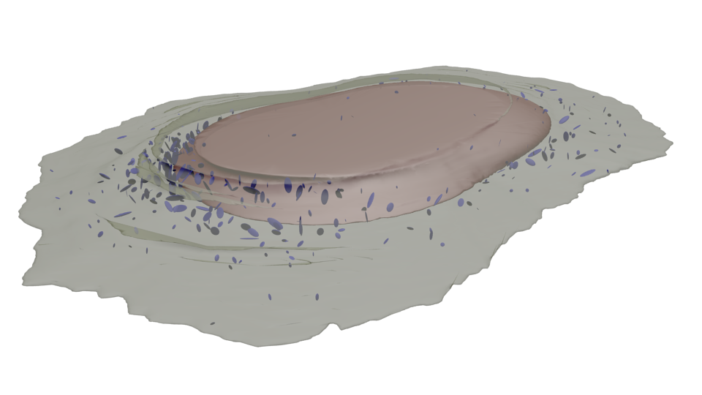
Identifying compartments
Extract compartment information from SBML
Identify relevant models using string matching
Generate SBML-spatial instances with biochemistry and necessary geometries
CellOrganizer
BNGL→SBML
Models:
Nuclear
Cell
Lysosome
Endosome
Mitochondria
Microtubule
Nucleosome
SBML-spatial+SBML

Slide 20
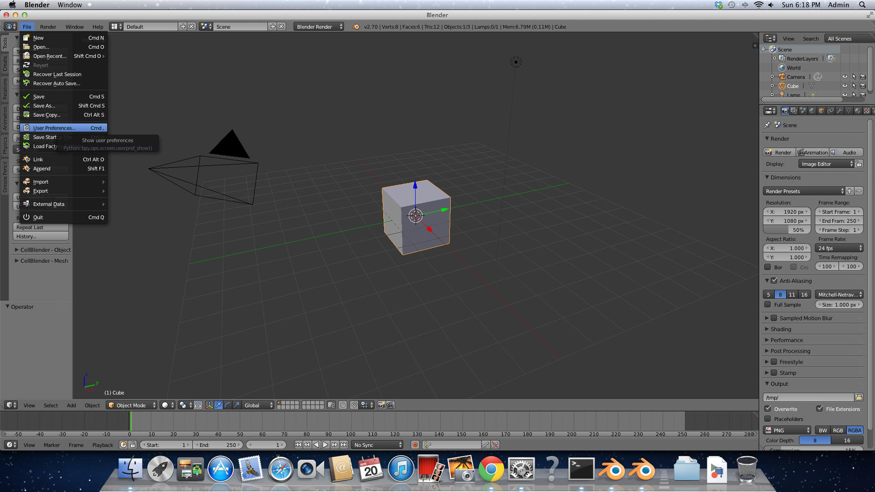
Installing CellBlender

Slide 21
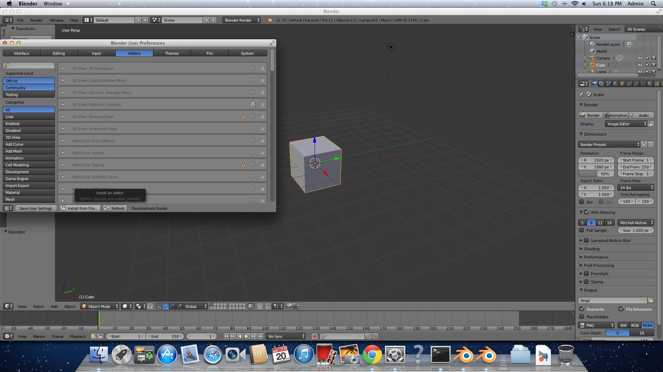
Installing CellBlender

Slide 22
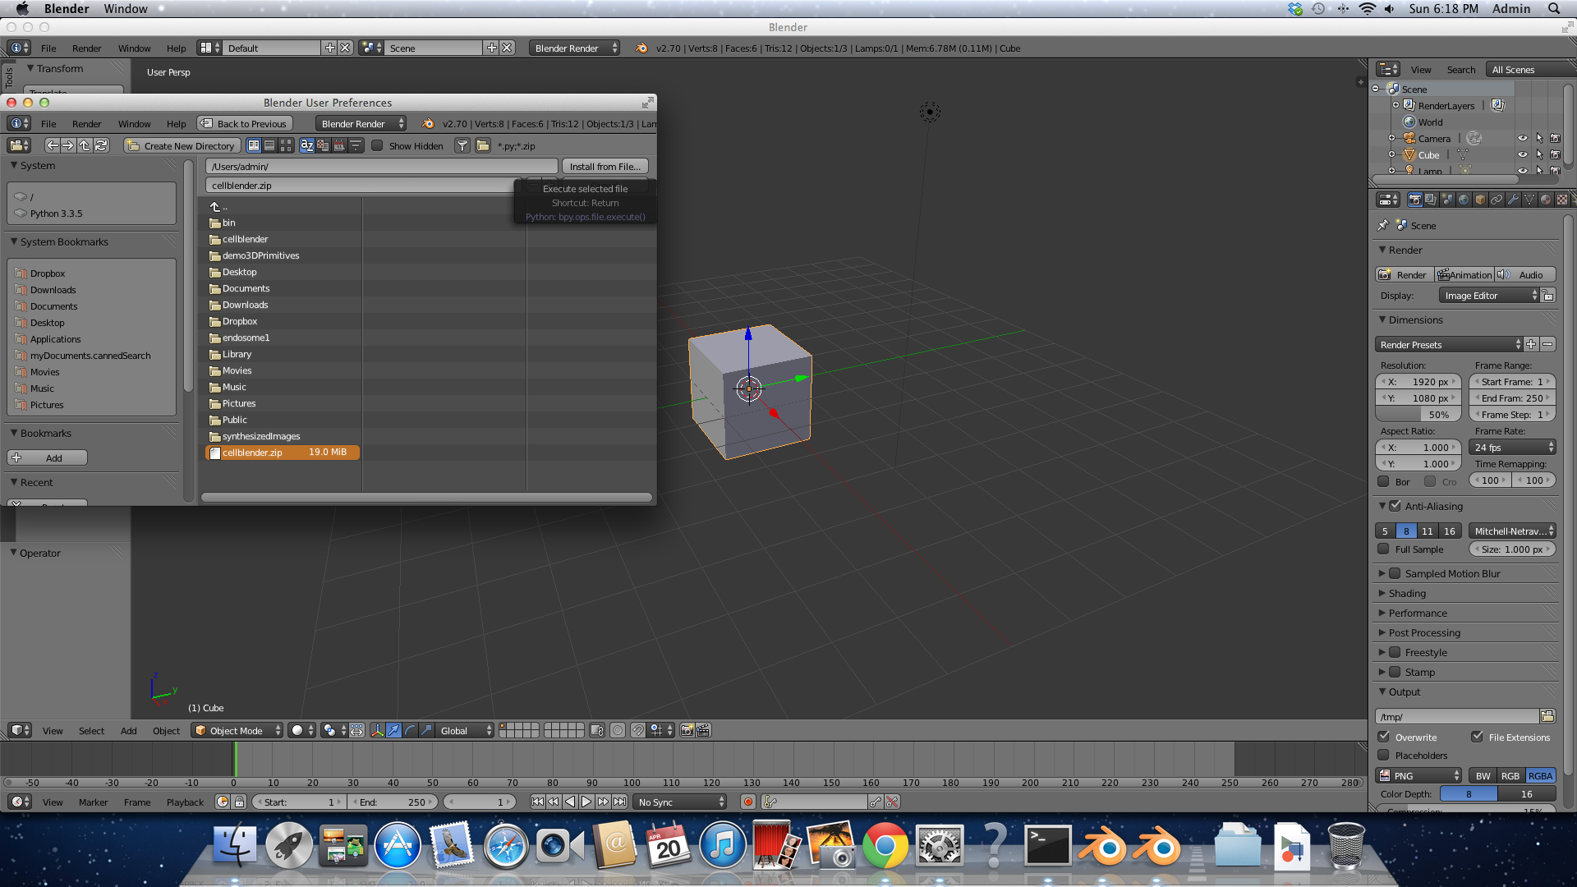
Installing CellBlender

Slide 23
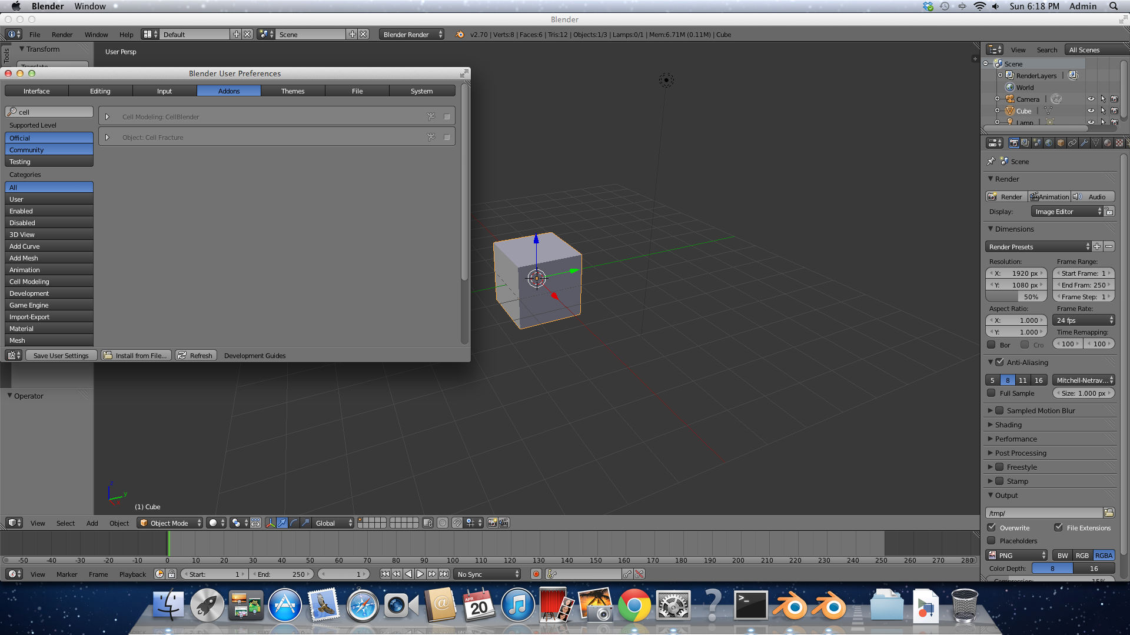
Installing CellBlender

Slide 24
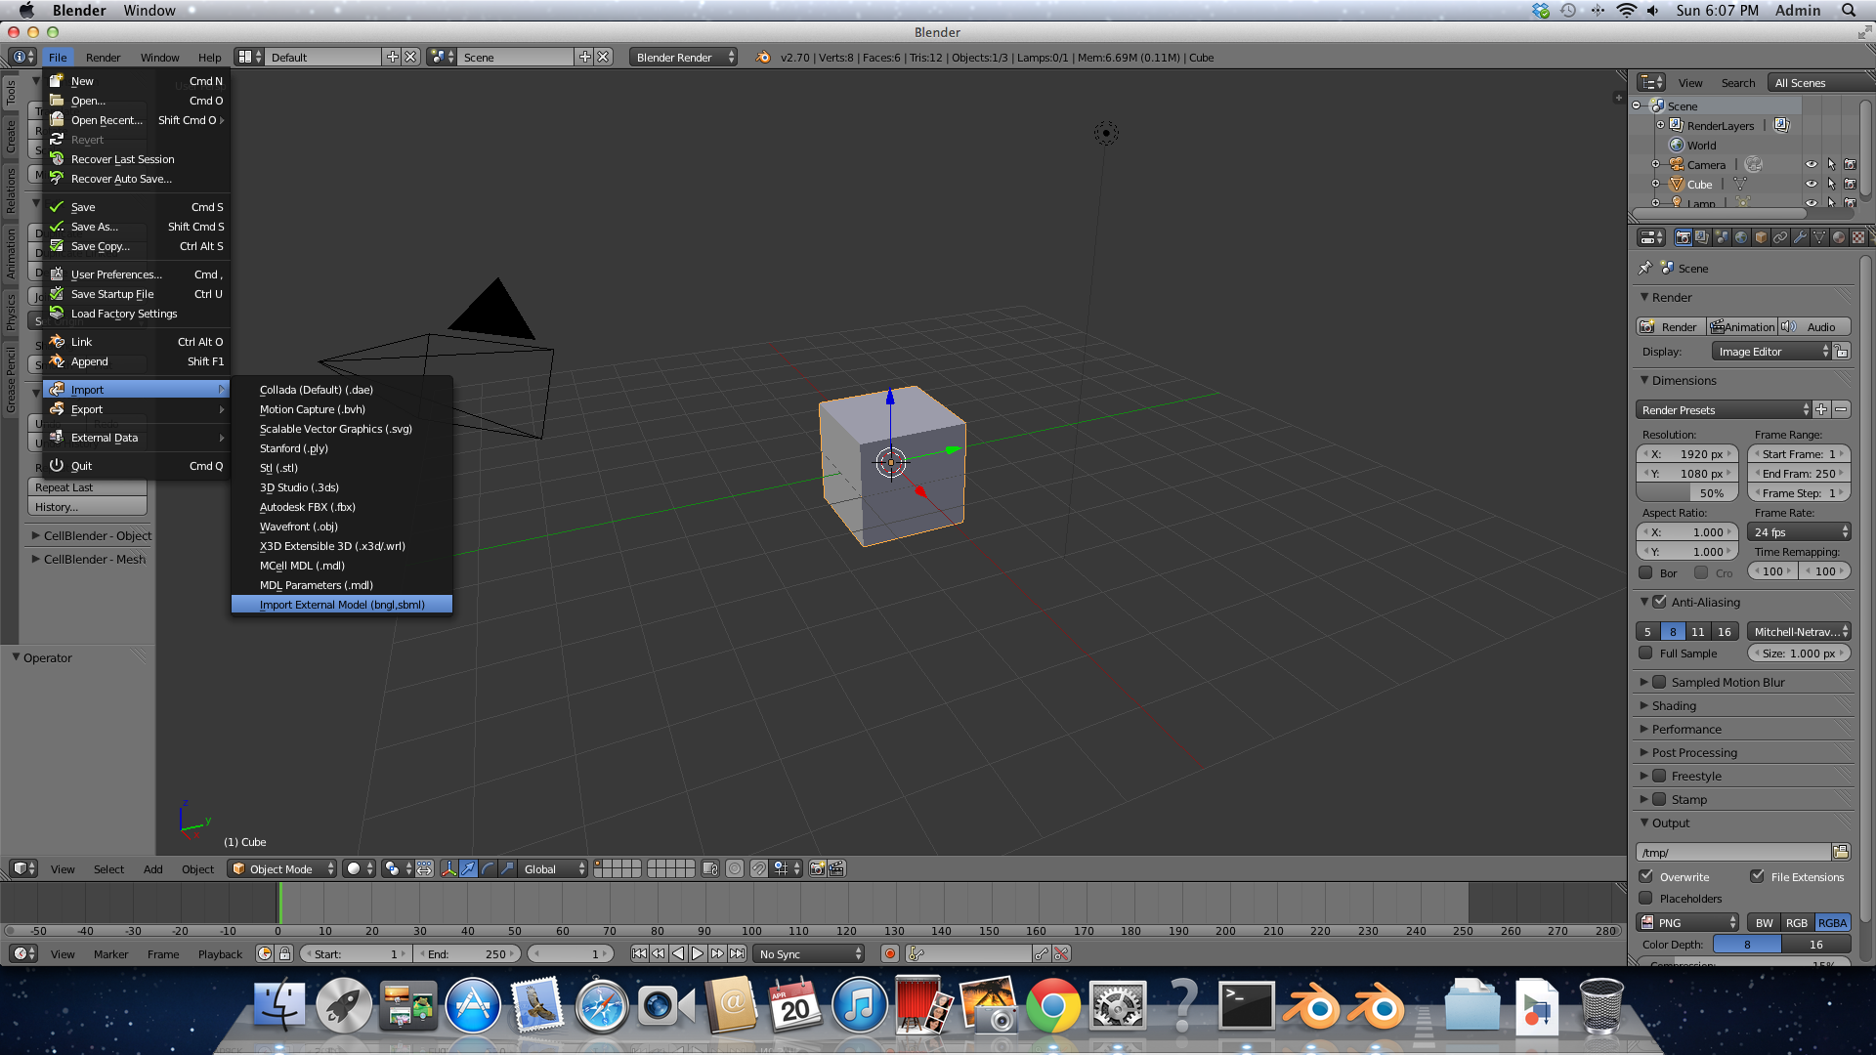
Importing SBML-spatial

Slide 25
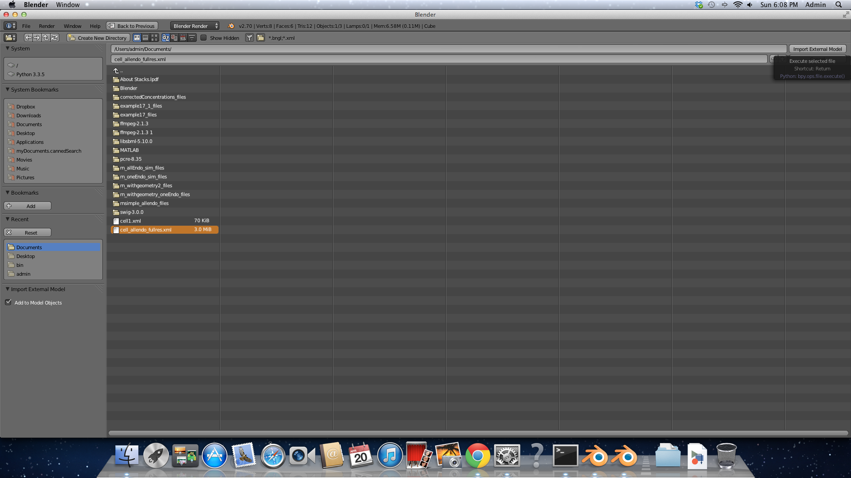
Importing SBML-spatial

Slide 26
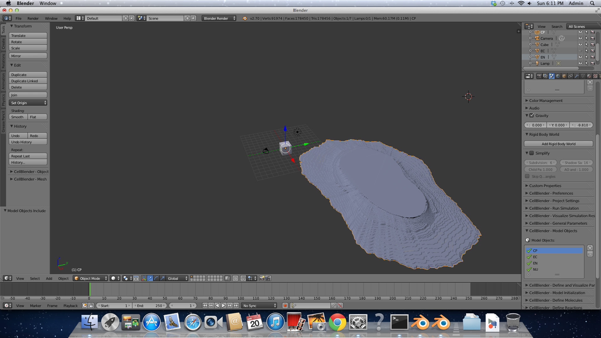
Importing SBML-spatial
Auto imports
Geometries
AND
Biochemistry!

Slide 27
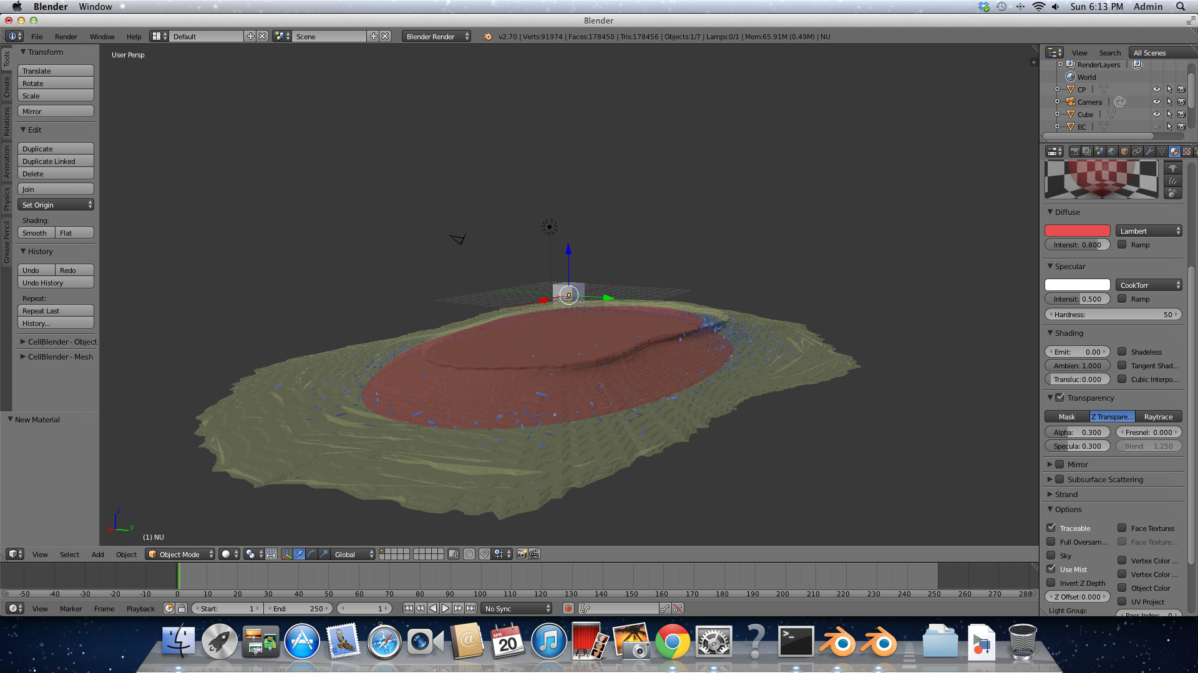
Make it pretty

Slide 28
Manual tuning
Fixing meshes
Must have consistent normals
Must be manifold
Must be watertight
Partition use/tuning to speed up simulations
Increases speed >1000x!

Slide 29
Automation of spatial modeling
Step 1: Biochemical systems modeling
BioNetGen
SBML
model
Experiments
&
Literature
Step 2: Creating realistic spatial geometries
Geometric
model
CellOrganizer
Step 3: Realistic spatial simulations
Mcell/VCell
SBML-spatial+SBML

Slide 30
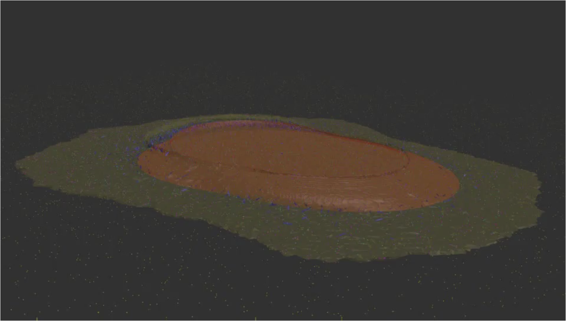
Whole cell simulations
Signal transduction network and geometry imported from SBML-spatial
Run for 100,000 steps of 10e-6s, 0.1s total
354 reactions, 78 species

Slide 31
Conclusions
Can build complex biochemical networks using Rule-based modeling (BNGL)
Can intelligently sample realistic cellular and organelle geometries
Can automatically combine biochemistry with appropriate geometric models
Can simulate whole cell bio-chemical systems in realistic geometries with minimal manual effort
Can now perform high-throughput spatial modeling of cells

Slide 32
Acknowledgments
Automation of simulations
Jose Juan Tapia
Jacob Czech
Rohan Arepally
Markus Dittrich Advisor
Robert Murphy
CellOrganizer
Gregory Johnson
Ivan Cao-Berg

