Slide 1


Computational Modeling of
TLR3-TLR7 Signaling Crosstalk
Bing Liu
Bahar Lab, TR&D 1 and 2

Slide 2
Immune System – two lines of defense
bacteria
viruses
fungi
…
www.nobelprize.org

Slide 3
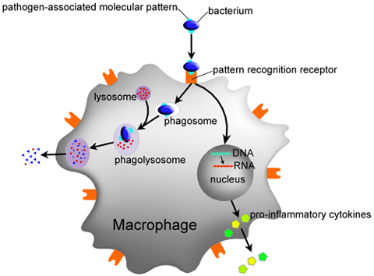
Innate Immune System
Recognize pathogens
Recruit immune cells to sites of infection (via cytokines)
Activate adaptive immune system (e.g. antigen presentation)
PAMP
  Bacteria: lipopolysaccharide (LPS), flagellin
  Viruses: dsRNA, ssRNA
PRR
  Toll-like receptors (TLR), nucleotide-binding oligomerization domain-containing protein (NOD)-like receptors, retinoic acid-inducible gene (RIG)-I-like receptors
PAMP
PRR
lpi.oregonstate.edu

Slide 4
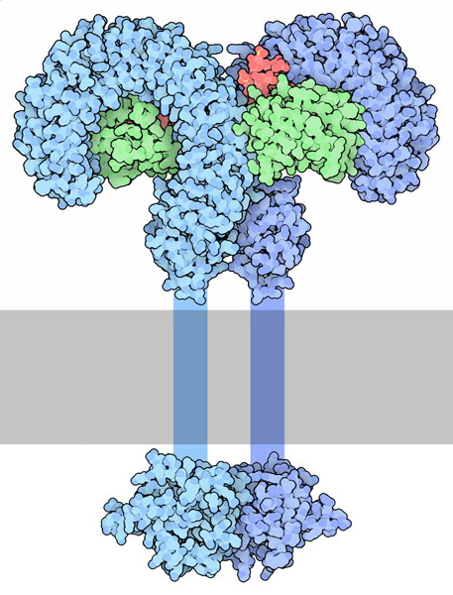
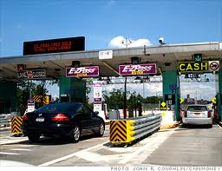
Toll-like Receptors
Toll ??

Slide 5
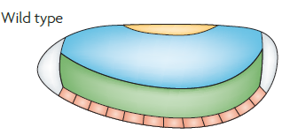
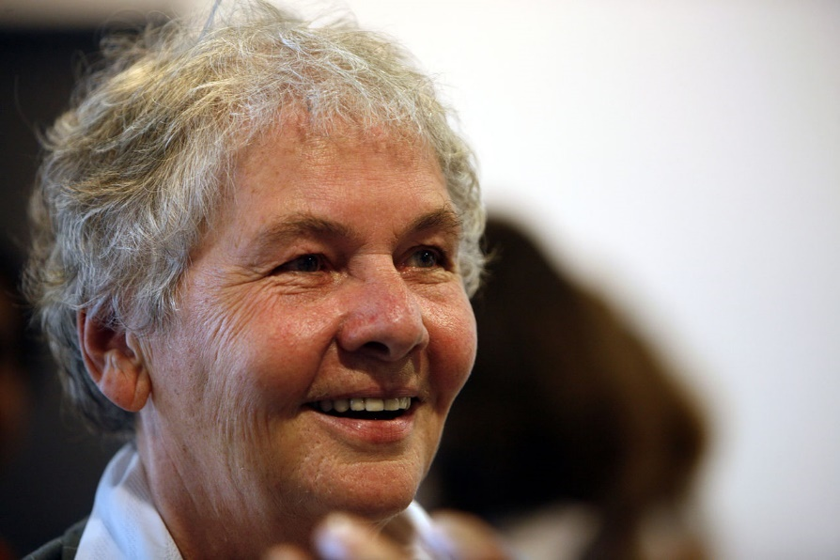
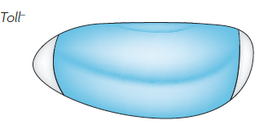

Toll-like Receptors
Fruit fly embryo
Toll gene
Das ist ja toll!
Christiane Nüsslein-Volhard, Nobel Prize 1995
Sommer, Nat Rev Genetics, 2009

Slide 6
Toll-like Receptors
Fruit fly embryo
Hedgehog gene
Hedgehog!
Christiane Nüsslein-Volhard, Nobel Prize 1995
Nüsslein-Volhard, Nature, 1980

Slide 7

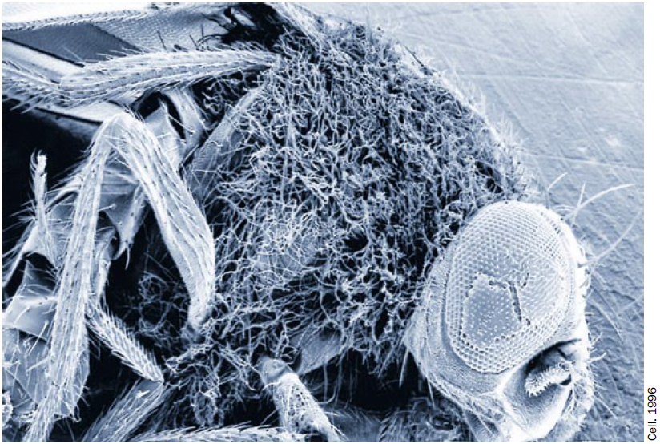
Toll-like Receptors
Toll gene
Jules A. Hoffmann, Nobel Prize 2011
Fruit flies with mutant Toll cannot fight off fungal infection

Slide 8
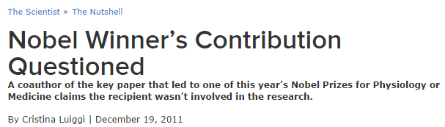
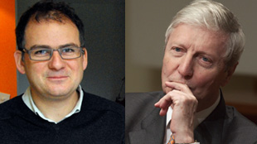
Toll-like Receptors
“Although I was expecting this news following rumours at the 2011 Toll meeting, I didn’t expect it so early. In a way, I am glad the jury selected our story on “Toll in Drosophila immunity” (Lemaitre et al. Cell 1996) since the discovery path identifying TLRs (Toll-like receptors) as major regulators of immunity was complex and also involved other key findings. […] In short, I feel disappointed because at the time that I performed the critical work on Toll, Jules Hoffmann was not very supportive of the genetics approach I had undertaken. Subsequently, he has never been able to fully recognize my contribution, yet somehow it is he who is now collecting the honours for my work.”
-- Bruno Lemaitre
Bruno Lemaitre
Jules A. Hoffmann

Slide 9
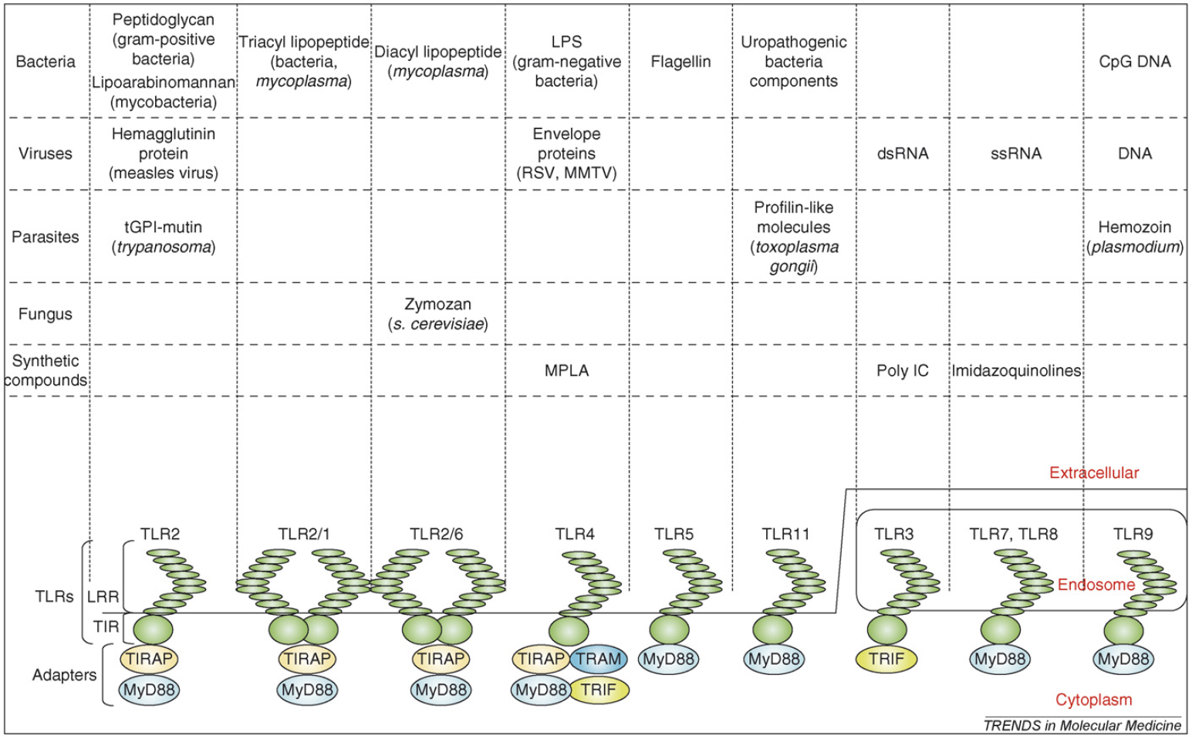
TLR Pathways
TLR crosstalk confers specificity to innate immunity (Tan et al, 2014)
  Combinatorial / sequential stimulations
  Synergy / antagonism
Kawai & Akira, 1980

Slide 10
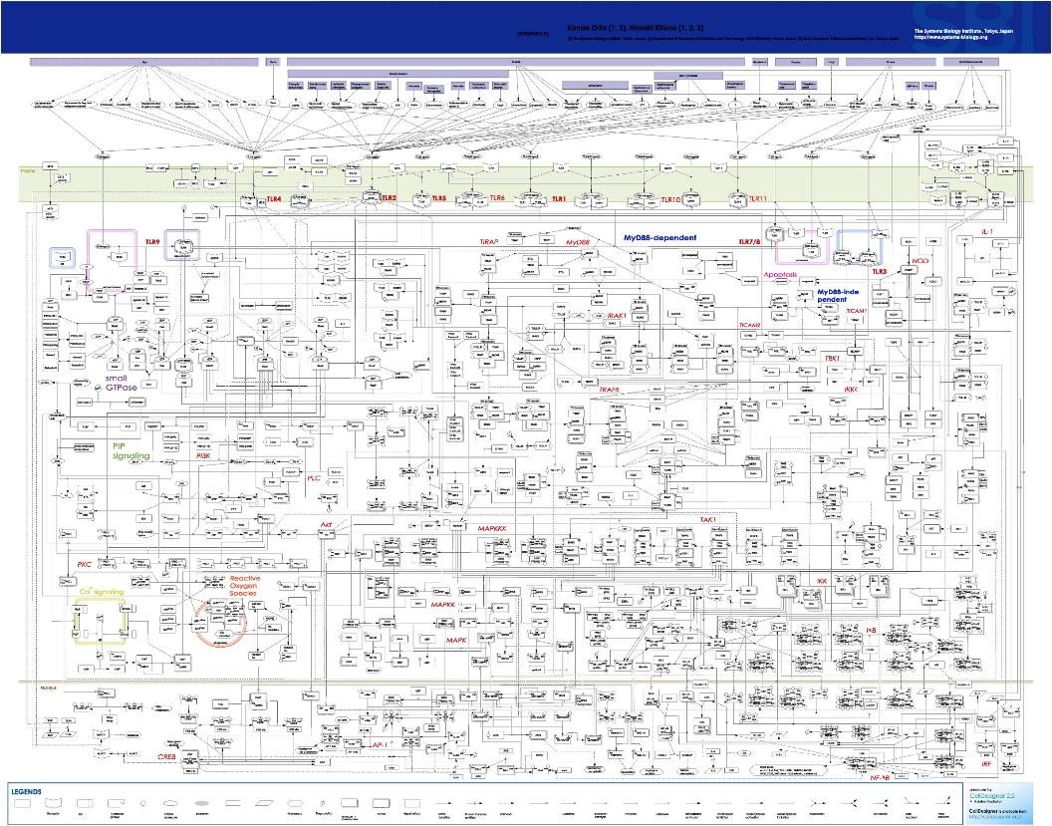
Oda & Kitano, Mol Syst Biol, 2006

Slide 11
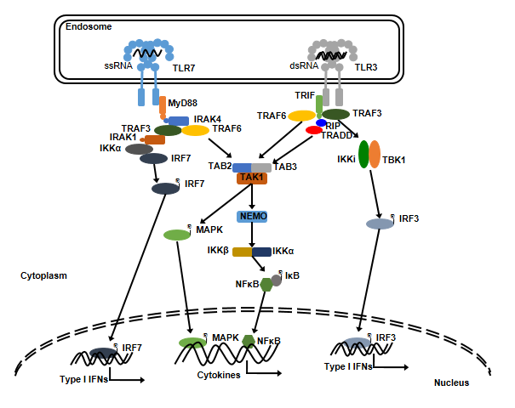
TLR3 and TLR7 Pathways
R848
Poly(I:C)
IL-6 IL-12

Slide 12
Key Observation - Synergy
Cell line: bone marrow derived macrophages (BMDM) extracted from 8-week old female mice
PAMP A
H₂O
Assay
Combinatorial stimulation
Δt= 0, 8, 24 h
4, 8, 16, 24 h
PAMP A
PAMP B
Assay
H₂O
PAMP B
Assay
Single stimulation control
Δt = 0, 8, 24 h
4, 8, 16, 24 h
Δt = 0, 8, 24 h
4, 8, 16, 24 h
A = poly(I:C) B = R848
A = poly(I:C) B = R848
A = R848 B = poly(I:C)
A = R848 B = poly(I:C)

Slide 13
Time-Dependent Synergy
I
- poly(I:C)
- R848
- Co-stimulation
R
IR
IL6 or IL12 mRNA level
Time after 2nd stimulation

Slide 14
Time-Dependent Synergy
I
- poly(I:C)
- R848
- Co-stimulation
R
IR
I8R
- 8 h delay
- 24 h delay
I24R
IL6 or IL12 mRNA level
Time after 2nd stimulation

Slide 15
Time-Dependent Synergy
I
- poly(I:C)
- R848
- Co-stimulation
R
RI
R8I
- 8 h delay
- 24 h delay
R24I
IL6 or IL12 mRNA level
Time after 2nd stimulation

Slide 16
Innate Immune Memory?
R848
Poly(I:C)
?
IL-6 IL-12

Slide 17

Our Goal
How do TLR3 and TLR7 pathways collaborate to enhance the immune response?
How to avoid excessive immune activation?

Slide 18
Type I IFN
Type I IFN
IL10
IFNAR1
Type I IFN
IL10R2
IL10R1
IFNAR2
TYK2
JAK1
Endosome
JAK1
TYK2
℗
ssRNA
TLR7
dsRNA
TLR3
STAT1
STAT2
STAT3
TRIF
MyD88
TRAF6
TRAF3
PI3K
NIK
TRAF3
IRAK4
RIP
IRAK1
TRAF6
TRADD
IKKα
IRF7
IKKi
TBK1
TAB2
TAB3
AKT
RELB
p100
℗
TAK1
IRF7
MKK4/7
MKK3/6
NEMO
℗
RELB
p52
JNK1/2
MKK1/2
IRF3
p38
ERK1/2
IKKβ
IKKα
Cytoplasm
℗
NFκB
IκB
X
Y
MSK1/2
℗
IRF3
Nucleus
℗
IRF7
AP-1
Type I IFNs
NFκB
℗
Type I IFNs
IRF3
Il6, Il12b
IRF9
IRF3 target gene X
STAT1
STAT2
NFκB
STAT1-STAT2 target gene Y
Il10

Slide 19
Type I IFN
Type I IFN
IL10
IFNAR1
Type I IFN
IL10R2
IL10R1
IFNAR2
TYK2
JAK1
Endosome
JAK1
TYK2
℗
ssRNA
TLR7
dsRNA
TLR3
STAT1
STAT2
STAT3
TRIF
MyD88
TRAF6
TRAF3
PI3K
NIK
TRAF3
IRAK4
RIP
IRAK1
TRAF6
TRADD
IKKα
IRF7
IKKi
TBK1
TAB2
TAB3
AKT
RELB
p100
℗
TAK1
IRF7
MKK4/7
MKK3/6
NEMO
℗
RELB
p52
JNK1/2
MKK1/2
IRF3
p38
ERK1/2
IKKβ
IKKα
Cytoplasm
℗
NFκB
IκB
X
Y
MSK1/2
℗
IRF3
Nucleus
℗
IRF7
AP-1
Type I IFNs
NFκB
℗
Type I IFNs
IRF3
Il6, Il12b
IRF9
IRF3 target gene X
STAT1
STAT2
NFκB
STAT1-STAT2 target gene Y
Il10

Slide 20
Computational Modeling

Slide 21
An ODE-based Model
97 species, 124 reactions, 147 parameters (120 unknowns)
  Association/dissociation, translocation: mass action kinetics
  Phosphorylation/activation: Michaelis-Menten kinetics
  Gene transcription: Kuttkrishnan et al, 2010

Slide 22

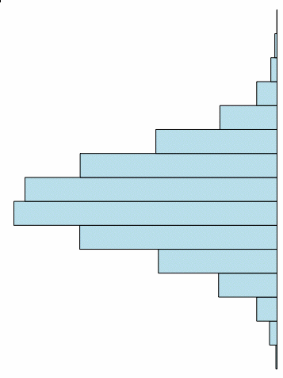
Model Calibration
Statistical model checking (SMC) based parameter estimation
  Encode training data as a bounded linear temporal logic formula
  Evaluate candidate parameters using SMC
  Perform global optimization (e.g. SRES)
Advantages:
  Utilize both quantitative and qualitative knowledge
  Deal with uncertainty of the initial states and the noisy cell-population data
  Good scalability due to the power of statistical testing
X

Slide 23
Model Prediction vs. Experimental data
Erk*
p38*
JNK*
IkBa*
R
I
IR
I8R
Experimental data
Model prediction

Slide 24
Model Prediction vs. Experimental data
The model fits both training data and test data
  Test dataset: [IL6mRNA], [IL12mRNA] at {0, 4, 8, 12, 16, 24, 28, 32, 40, 48 h} under I24R condition
Experiment
Model
IL-12mRNA [a.u.]
IL-12mRNA [a.u.]
IL-6mRNA [a.u.]
IL-6mRNA [a.u.]
Time [h]
Time [h]

Slide 25
Sensitivity Analysis
Identify critical species and reactions
Local sensitivity:
  The sensitivity coefficient S_{ij} is defined as the normalized first order derivatives of the model output O_{i} with respect to the model parameter P_{i}
Global sensitivity:
  Assess the overall effects of parameters on the model output by simultaneously perturbing all the parameters within a parameter space
  SMC-based multi-parameter sensitivity analysis (MPSA)

Slide 26
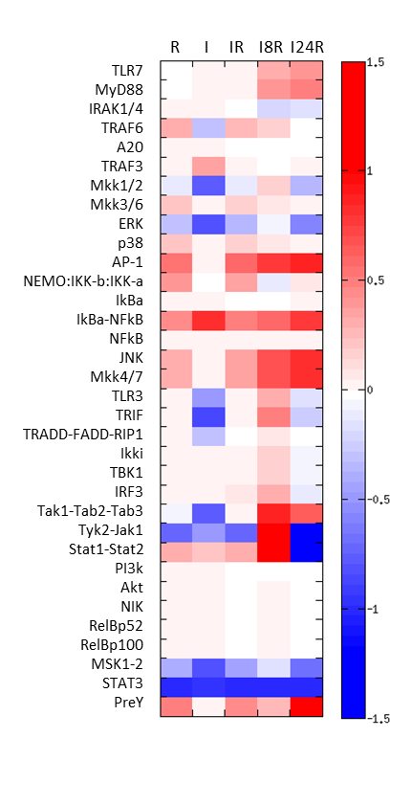
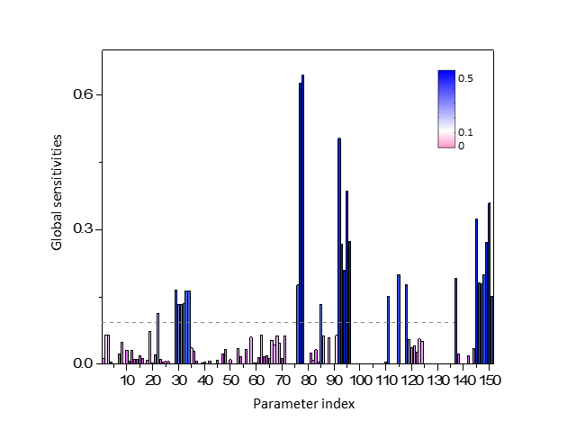
Sensitivity Analysis
Local SA
Global SA
IL-12
JAK-STAT
IL10-STAT3
NFkB
IFN

Slide 27
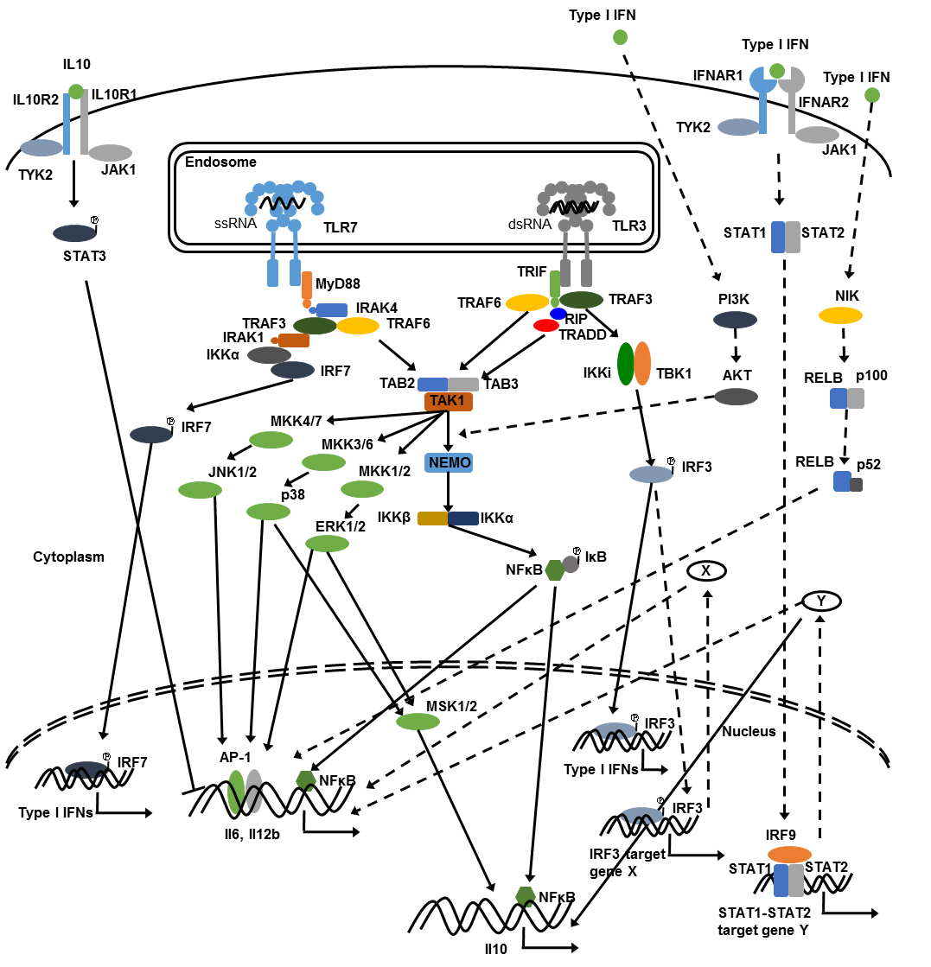
Sensitivity Analysis - Insights
Local sensitivity of initial concentrations under 5 conditions
  MAPKs, AP-1
  IkBa-NFkB, Tyk2-Jak1, STAT1-STAT2
  MSK1-2, STAT3
Global sensitivity of kinetic parameters under I8R
  IL12, NFkB, JAK-STAT1, IFN, IL10-STAT3

Slide 28
Why Synergy?
The role of IFN
  IFN production is predominately governed by TLR3 activation, while cytokine production is regulated by a subtle coordination of TLR3 and TLR7 pathways
Cytokines
Interferon
Increasing Δt
IL-12 mRNA [nM]
IFN [nM]
Increasing Δt
Time [h]
Time [h]

Slide 29
Why Synergy?
The role of IFN
  IFN production is predominately governed by TLR3 activation, while cytokine production is regulated by a subtle coordination of TLR3 and TLR7 pathways
Cytokines
Interferon
Increasing Δt
Increasing Δt
IL-12 mRNA [nM]
IFN [nM]
Time [h]
Time [h]

Slide 30
Type I IFN
Type I IFN
Type I IFNs
IL10
IFNAR1
Type I IFN
IL10R2
IL10R1
IFNAR2
TYK2
JAK1
Endosome
JAK1
TYK2
℗
ssRNA
TLR7
dsRNA
TLR3
STAT1
STAT2
STAT3
TRIF
MyD88
TRAF6
TRAF3
PI3K
NIK
TRAF3
IRAK4
RIP
IRAK1
TRAF6
TRADD
IKKα
IRF7
IKKi
TBK1
TAB2
TAB3
AKT
RELB
p100
℗
TAK1
IRF7
MKK4/7
MKK3/6
NEMO
℗
RELB
p52
JNK1/2
MKK1/2
IRF3
p38
ERK1/2
IKKβ
IKKα
Cytoplasm
℗
NFκB
IκB
X
Y
MSK1/2
℗
IRF3
Nucleus
℗
IRF7
AP-1
Type I IFNs
NFκB
℗
Type I IFNs
IRF3
IL-6, IL-12b
IRF9
IRF3 target gene X
STAT1
STAT2
NFκB
STAT1-STAT2 target gene Y
Il10

Slide 31
Why Synergy?
Hypothetical mechanisms
  IRF3 target genes
  JAK-STAT
  NFκB inducing kinase (NIK)
  PI3K-AKT
Knockout AKT crosstalk
Knockout IRF3 crosstalk
Knockout NIK crosstalk
Knockout JAK-STAT crosstalk

Slide 32
Why Synergy?
Type I IFN
Endosome
TLR7
TLR3
ssRNA
dsRNA
JAK-STAT1/2
MyD88
TRIF
TAB2
TAK1
TAB3
MAPKs
℗
NFκB
IκB
Cytoplasm
IRF3
℗
Nucleus
℗
IRF7
AP-1
NFκB
Type I IFNs
Type I IFNs
Il6, Il12b
Priming
STAT1
STAT2
Target gene Y

Slide 33
Why time- & order-dependent?
Factor Y’s activity is transient
R8I and R24I conditions: insufficient AP-1 and NFkB
AP-1
NFkB
Factor Y
Factor Y
And
IL-12 mRNA [nM]
IL-6, IL-12
Time [h]

Slide 34
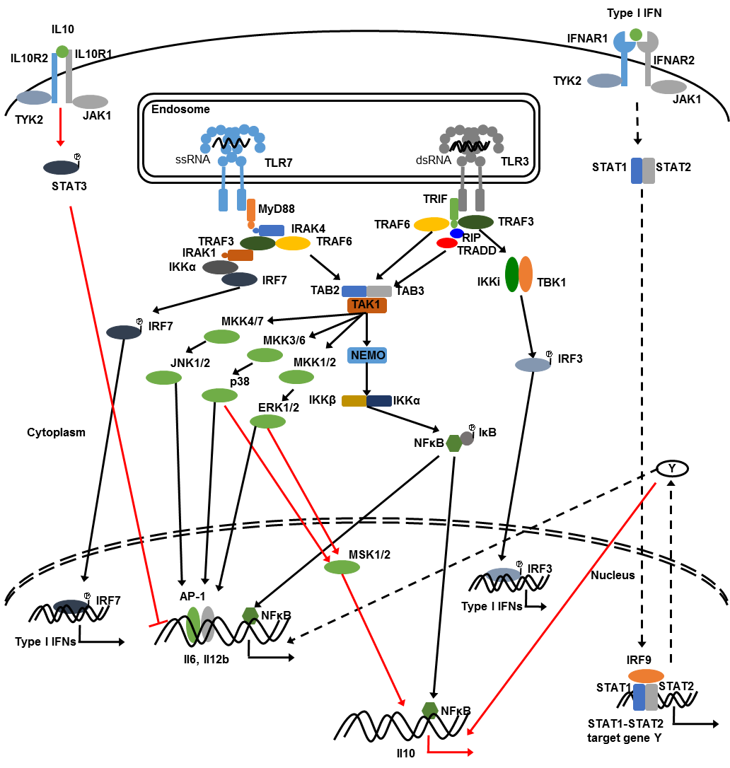
Inhibitory Mechanism
IL10-STAT3 pathway
Incoherent feed-forward loops (IFFLs)
p38, ERK, STAT1
IL-10
IL-6, IL-12

Slide 35
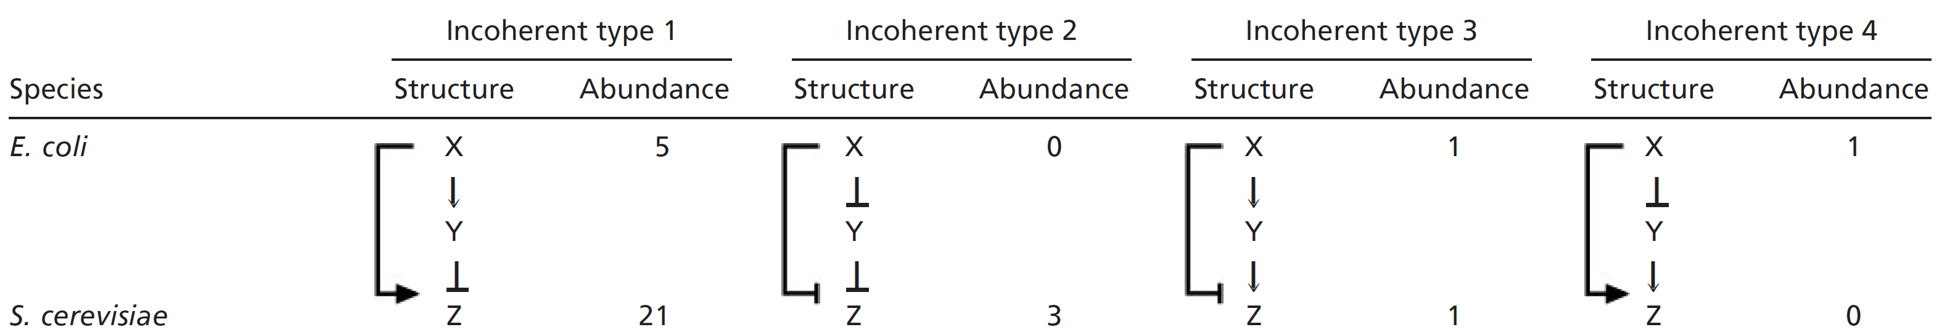
Incoherent Feedforward Loops
Magan & Alon, PNAS, 2003

Slide 36
The Utility of Type 1 IFFL
Robustness, homeostasis, …
Speedup of gene-circuit response time
Pulse generation
Generation of non-monotonic input-output relations (biphasic response)
Fold-change detection

Slide 37
Knockdown of STAT1
Knockdown of STAT1 increase the synergy (8 h under IR)
*
*
IL-6 mRNA [nM]
IL-12 mRNA [nM]
Time [h]
Time [h]

Slide 38
Knockdown of MAPKs
No inhibitor
JNK inhibitor
ERK inhibitor
P38 inhibitor
No inhibitor
JNK inhibitor
ERK inhibitor
P38 inhibitor
IL-6 mRNA [nM]
IL-12 mRNA [nM]
Time [h]
Time [h]

Slide 39
The Utility of Type 1 IFFL
Robustness, homeostasis, …
Speedup of gene-circuit response time
Pulse generation
Generation of non-monotonic input-output relations (biphasic response)
Fold-change detection
STAT1
IL-12 mRNA [nM]
IL-10
IL-6, IL-12
0.01 0.1 1 10
STAT1 [nM] log scale

Slide 40
Conclusion
A mathematical model of TLR3-TLR7 signaling network
We identified a STAT1-medited synergistic mechanism
We analyzed the role of I1FFLs induced by IL-10
The model revealed how macrophages create ‘innate immune memory’ by priming the cell for the second round of PAMP challenge, and at the same time, maintain homeostasis by negative regulators

Slide 41
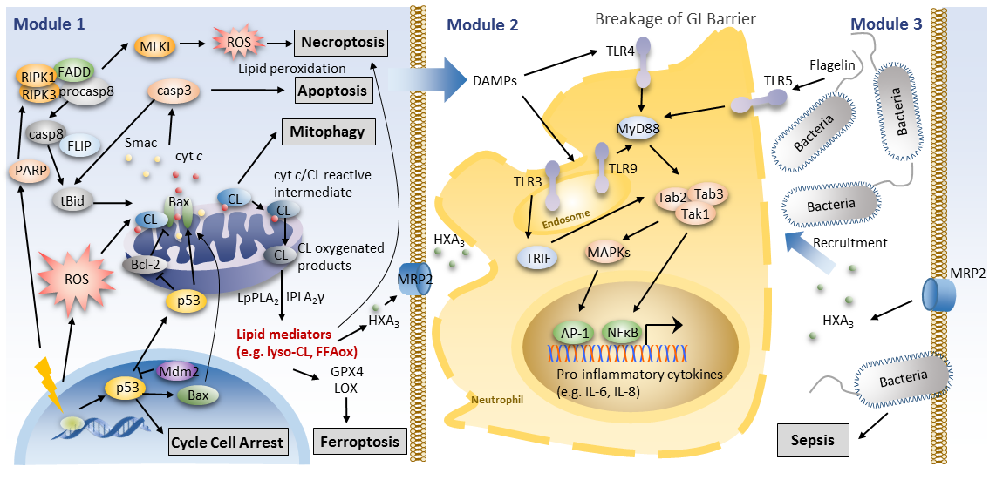
Current work

Slide 42
Acknowledgements
University of Pittsburgh
Ivet Bahar
Carnegie Mellon University
Edmund M. Clarke
National University of Singapore
P. S. Thiagarajan
Jeak-Ling Ding

